Slide 1
Group Members
Amar Shafiq FA21-BCS-10
Subhan Nagra FA21-BCS-10
Muhammd Uzair SP22-BCS-
Kashif Ali FA21-BCS-106

Slide 2

Stack using Queue

Slide 3
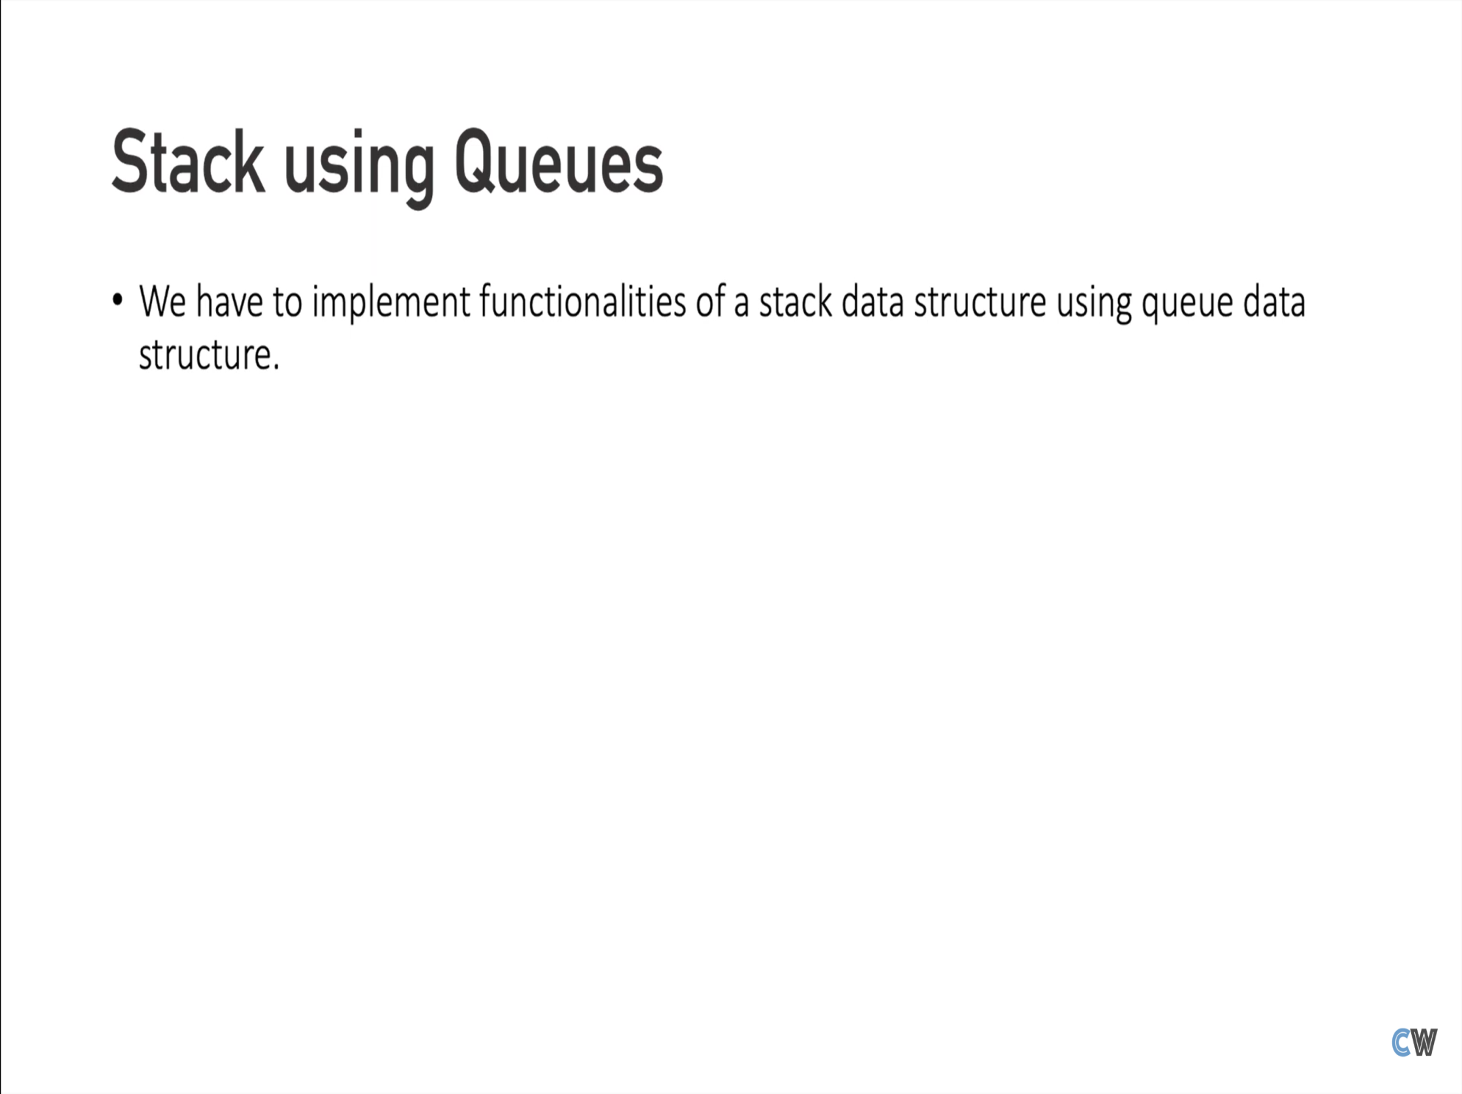

Slide 4
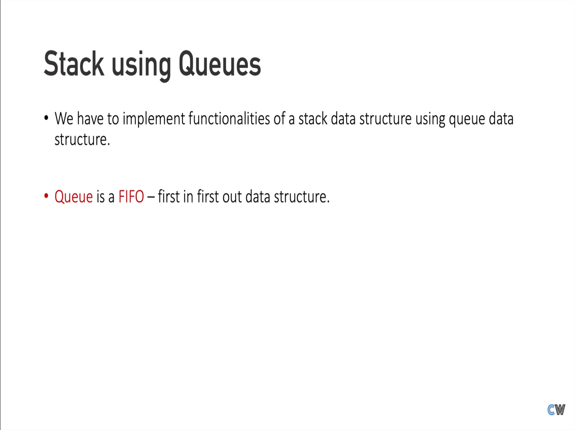

Slide 5
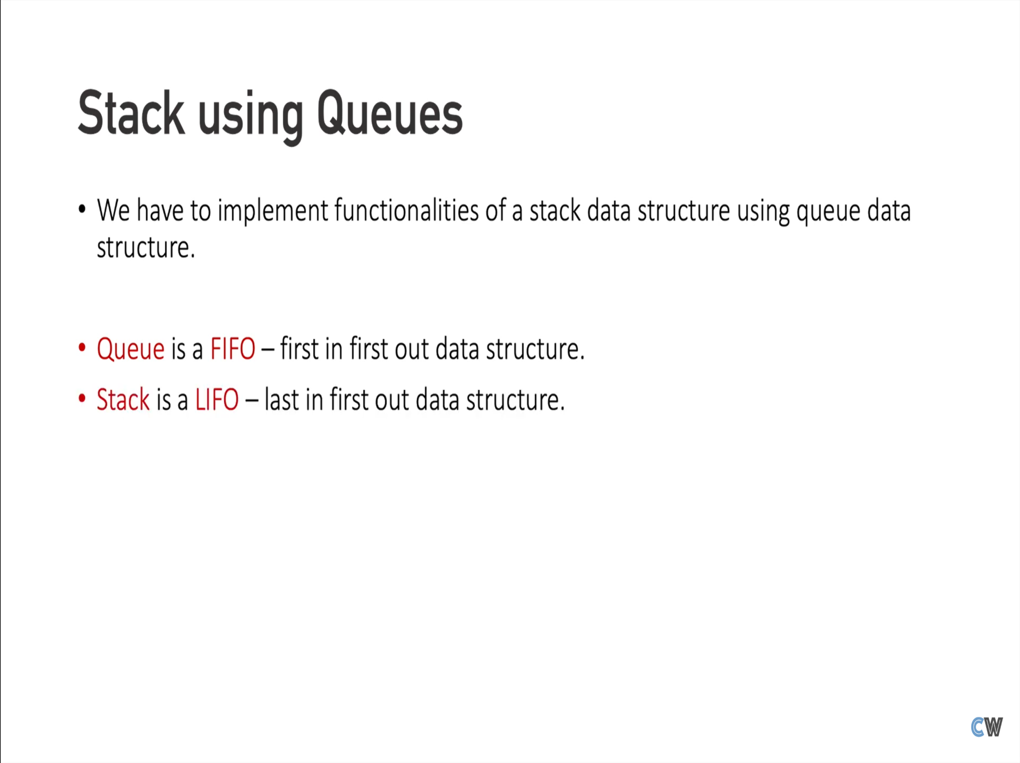

Slide 6
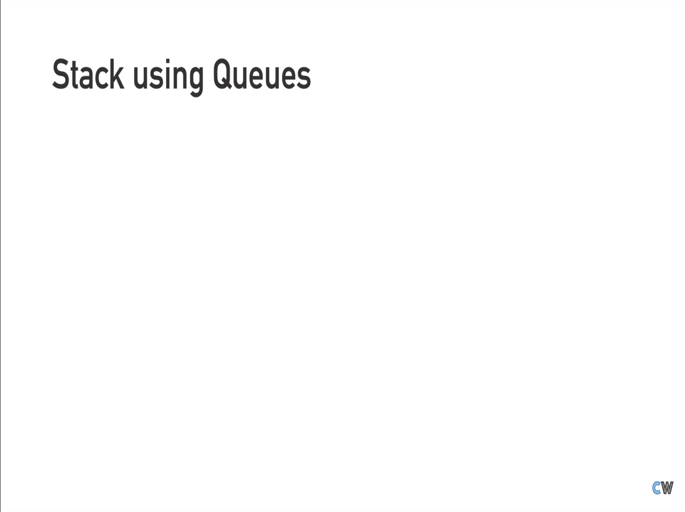

Slide 7
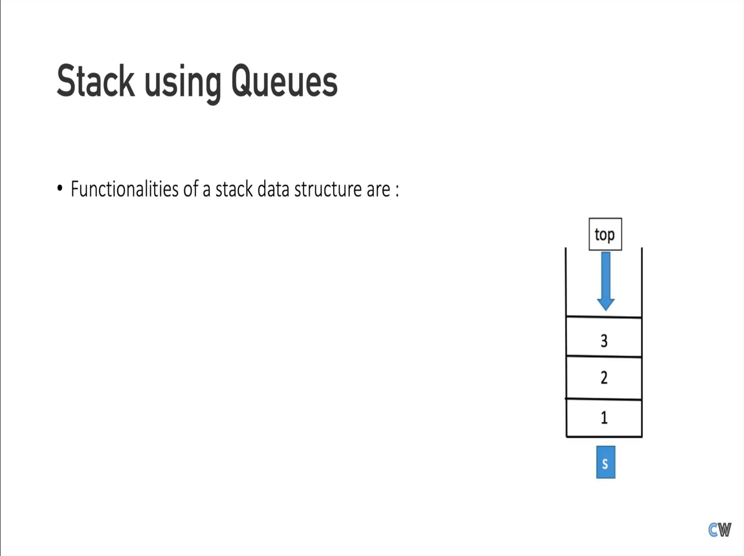

Slide 8
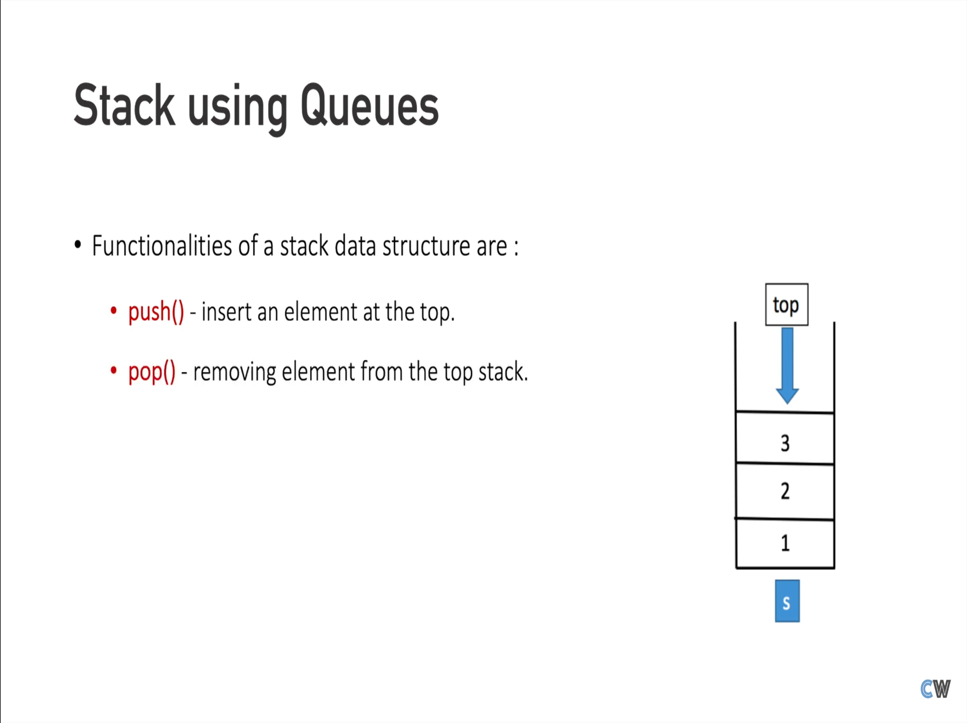

Slide 9
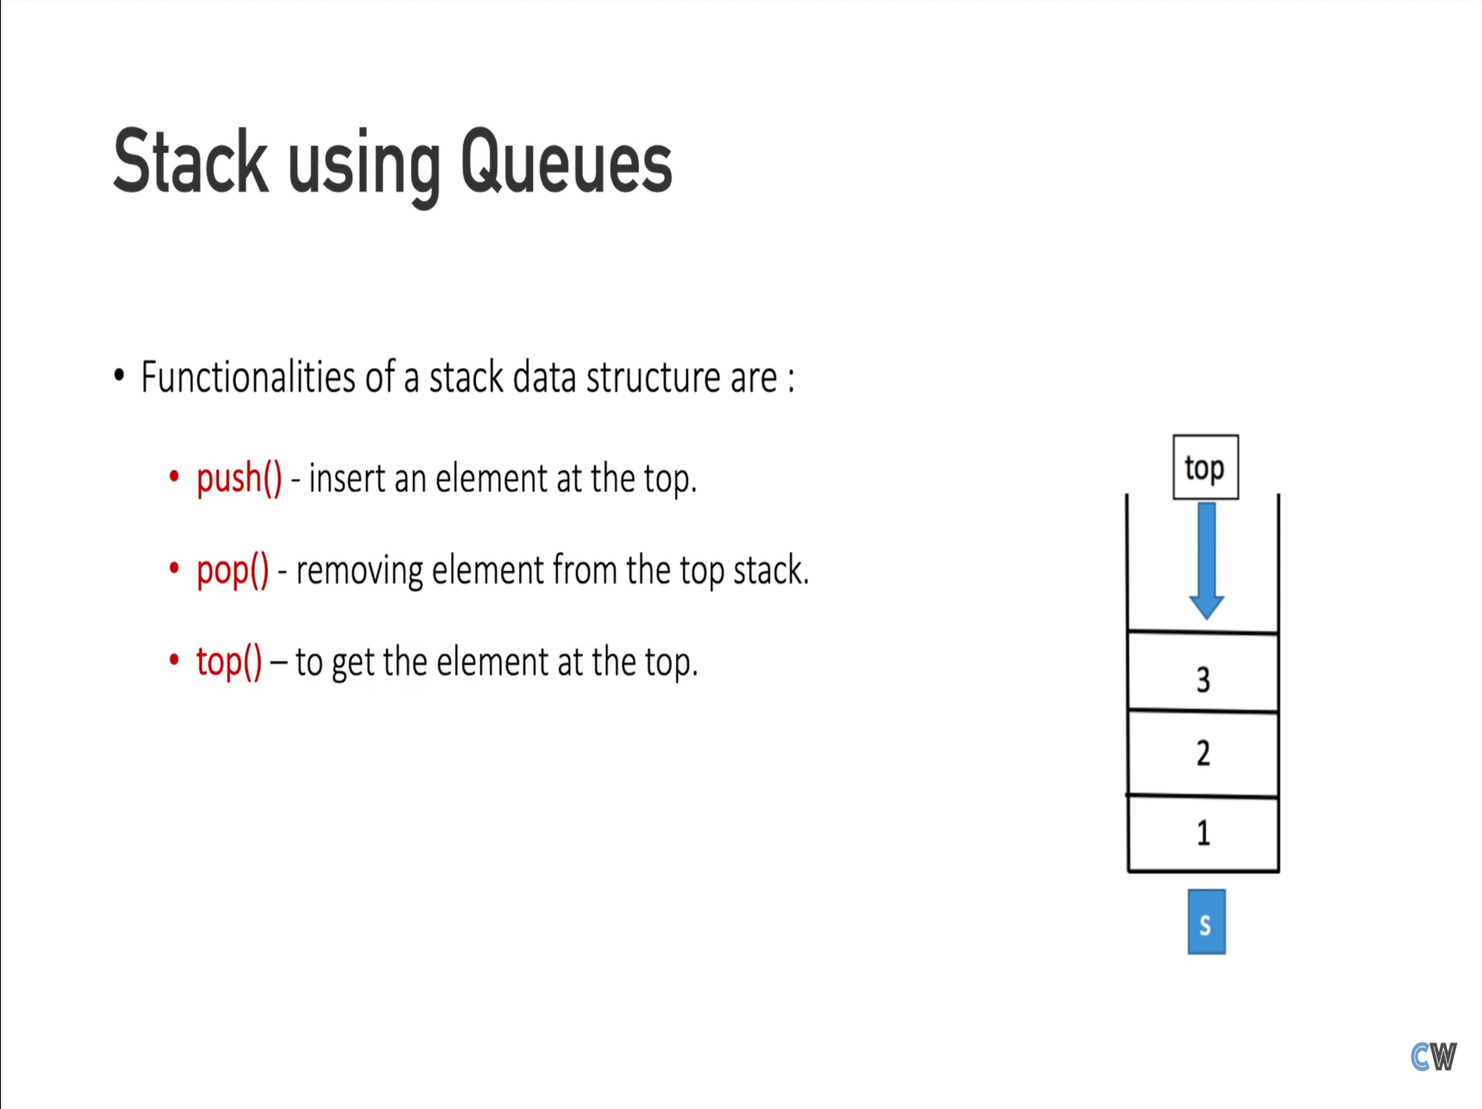

Slide 10
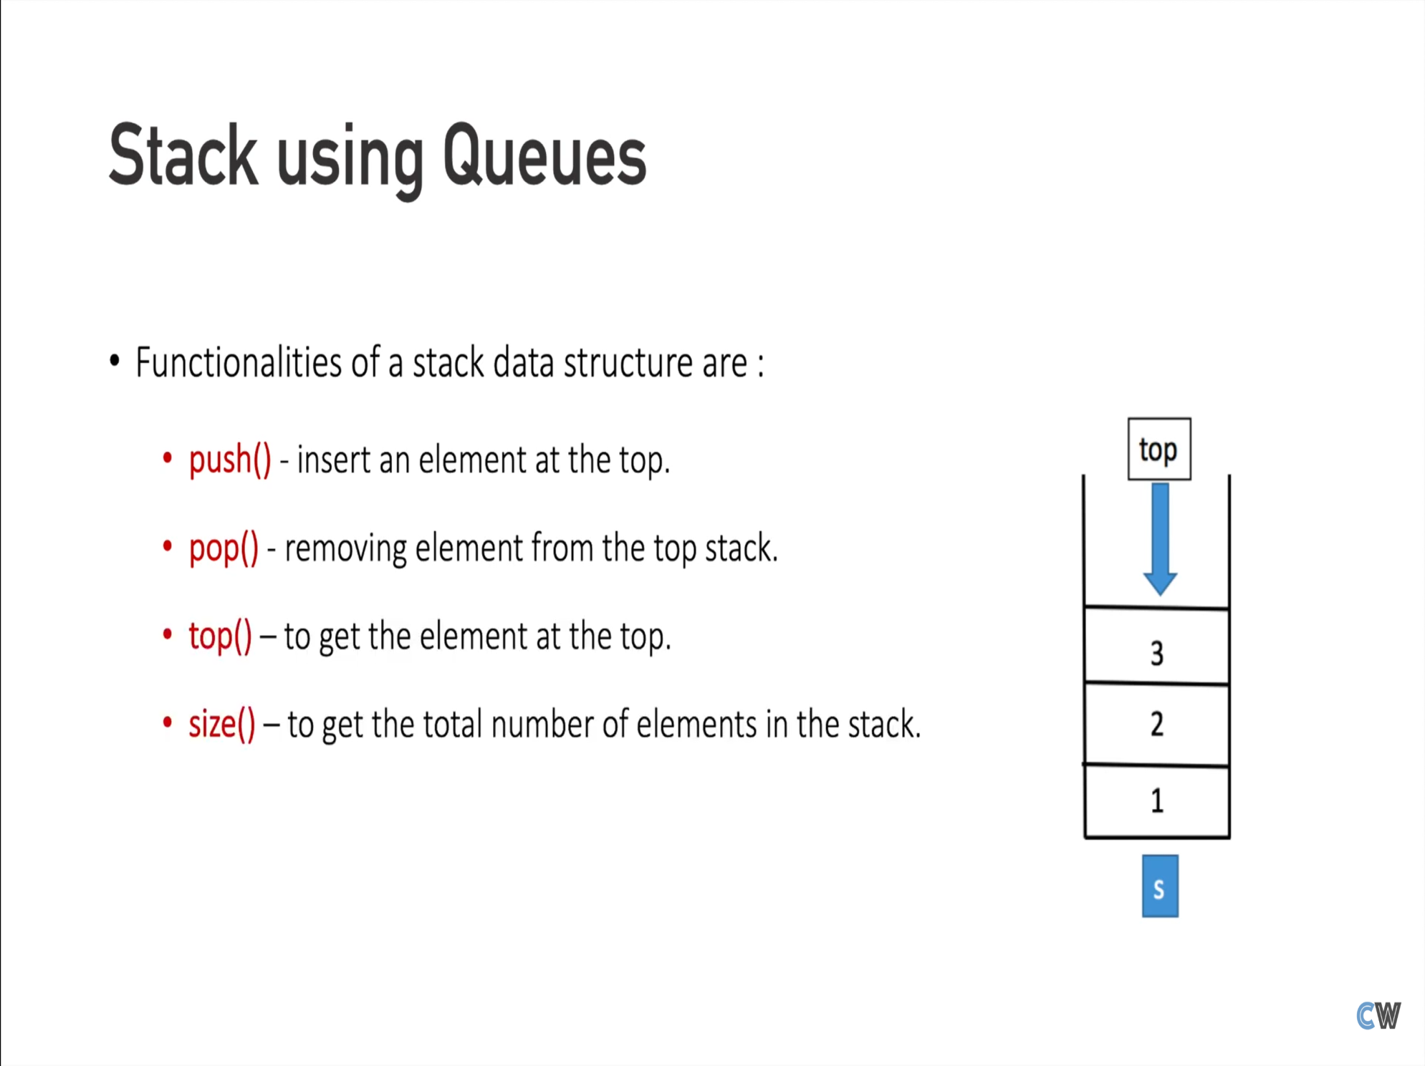

Slide 11
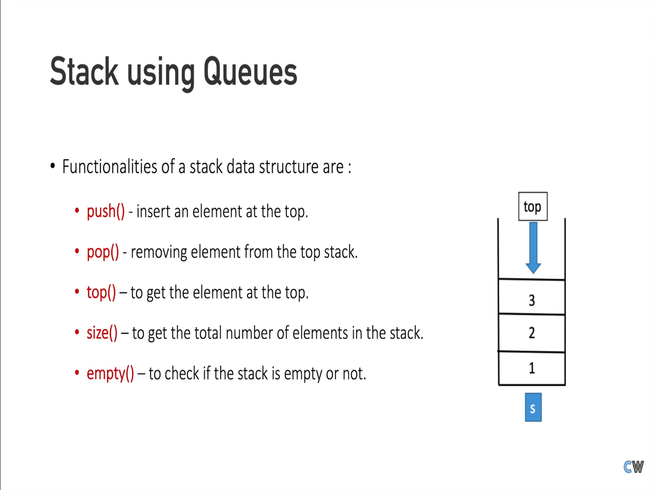

Slide 12
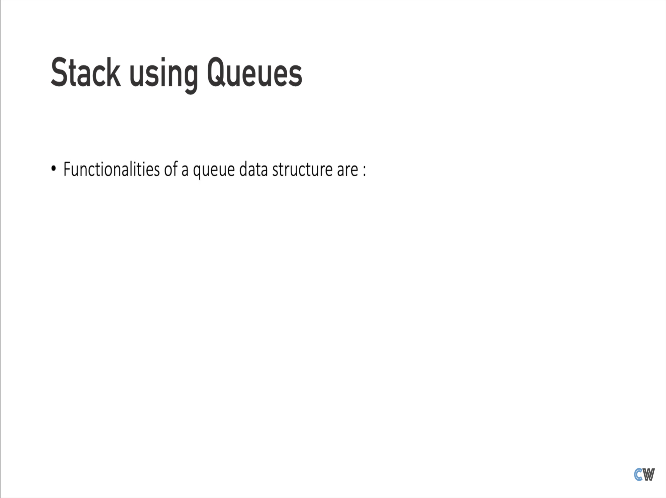

Slide 13
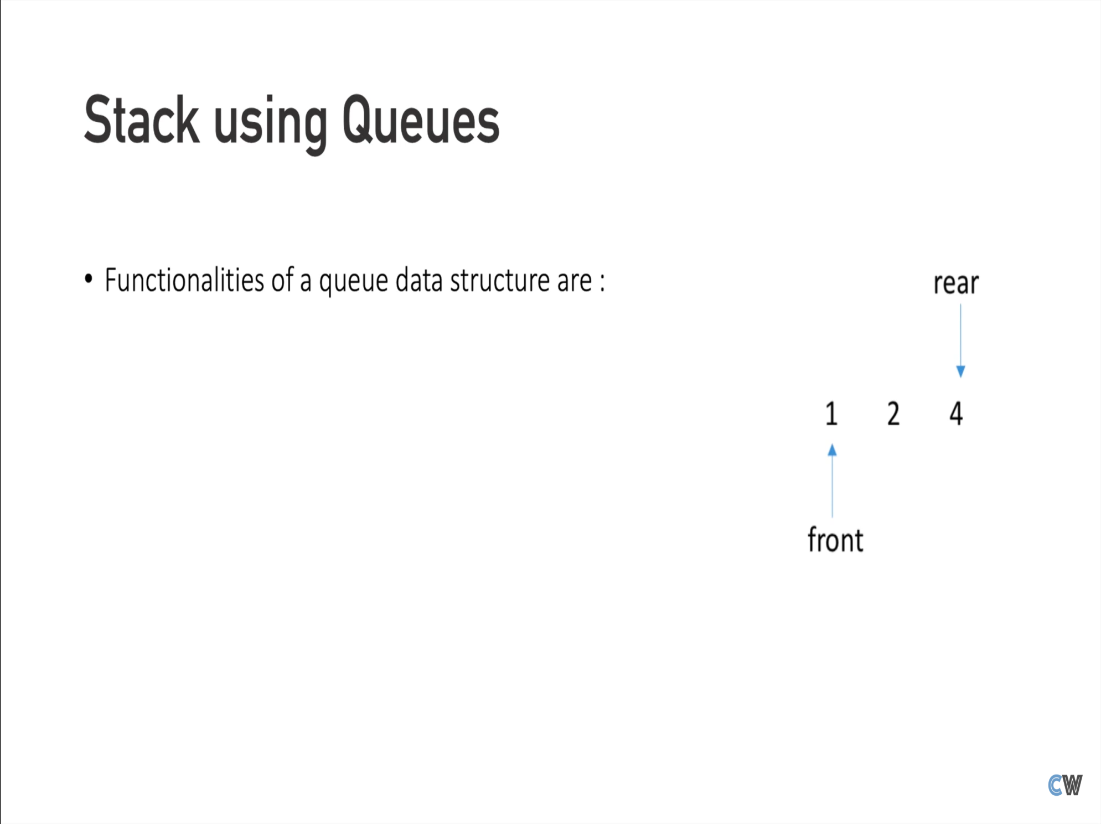

Slide 14
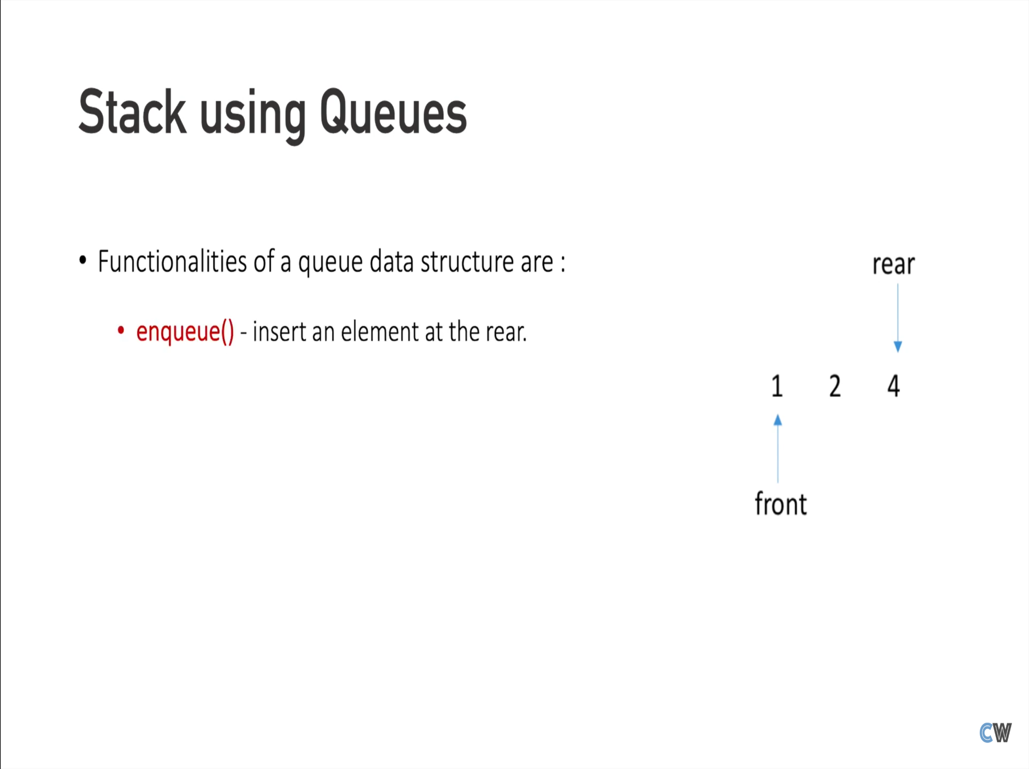

Slide 15
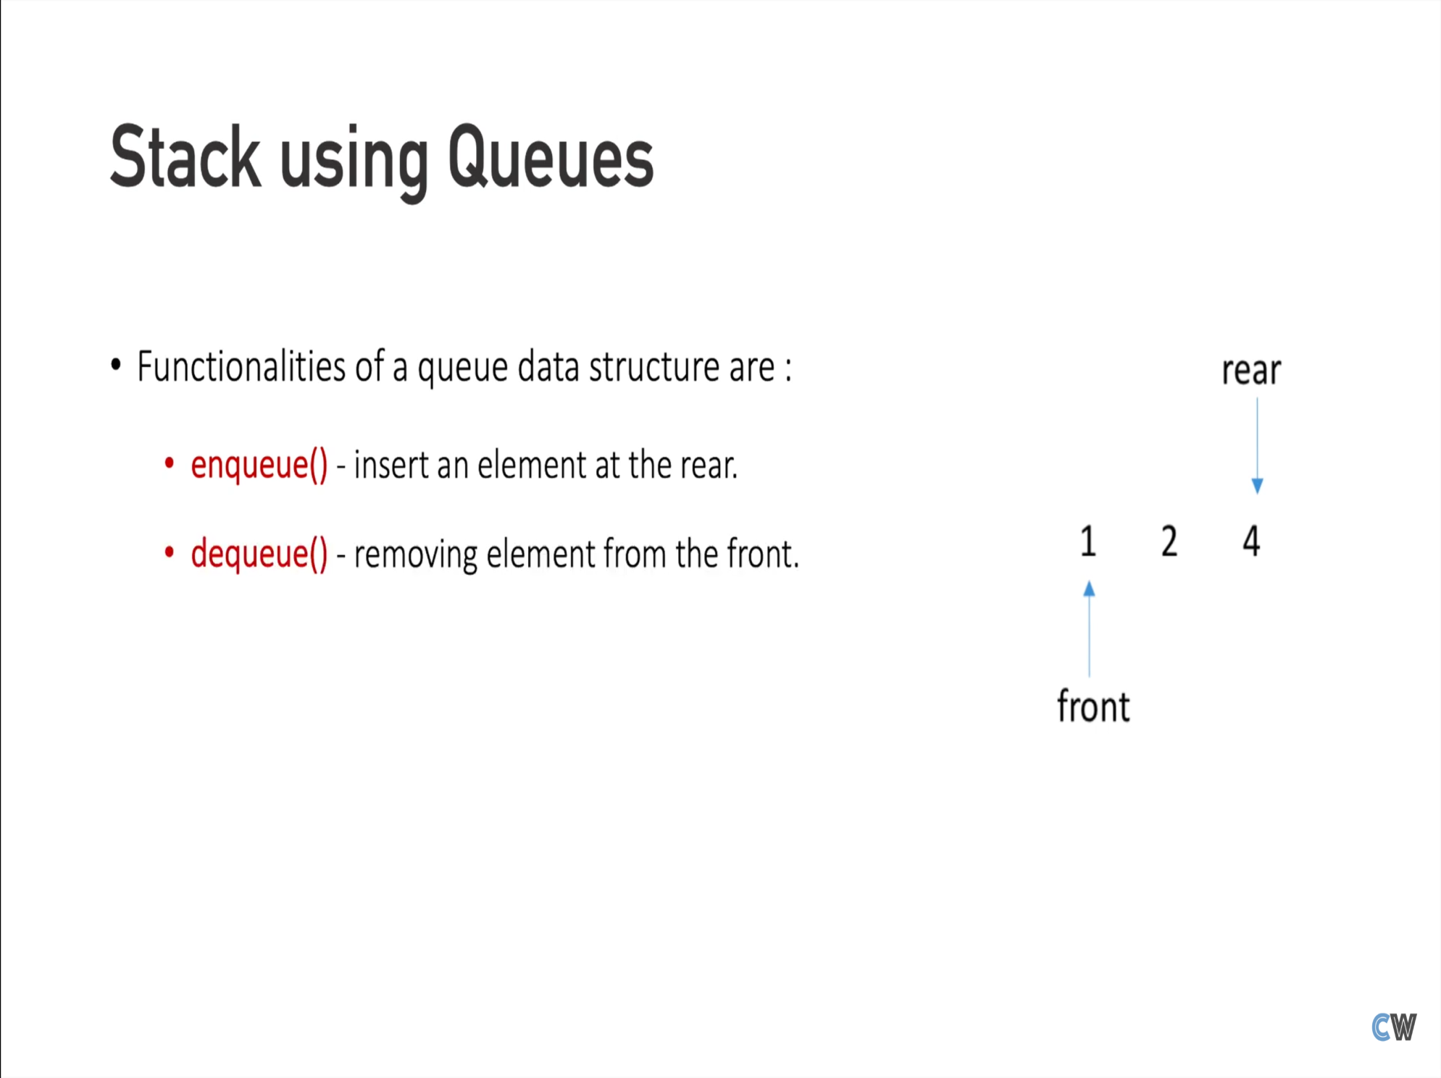

Slide 16
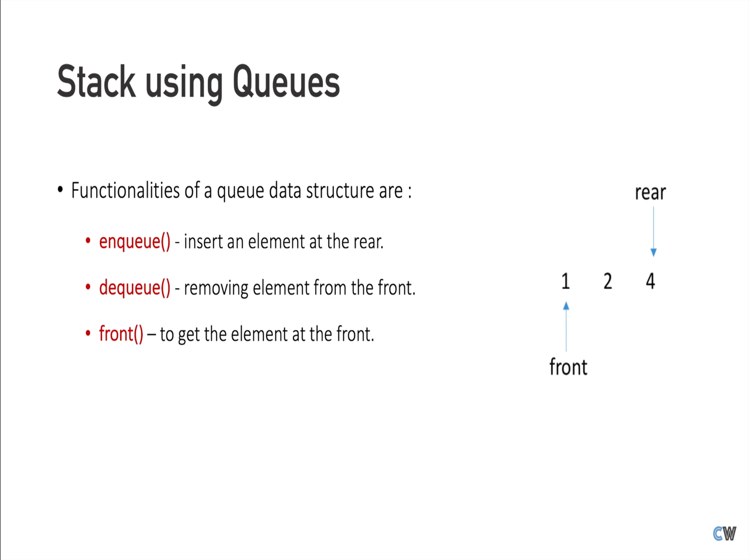

Slide 17
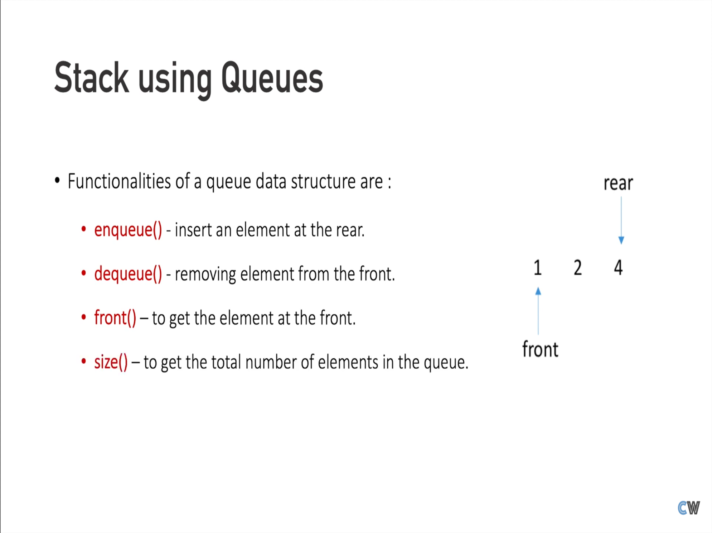

Slide 18
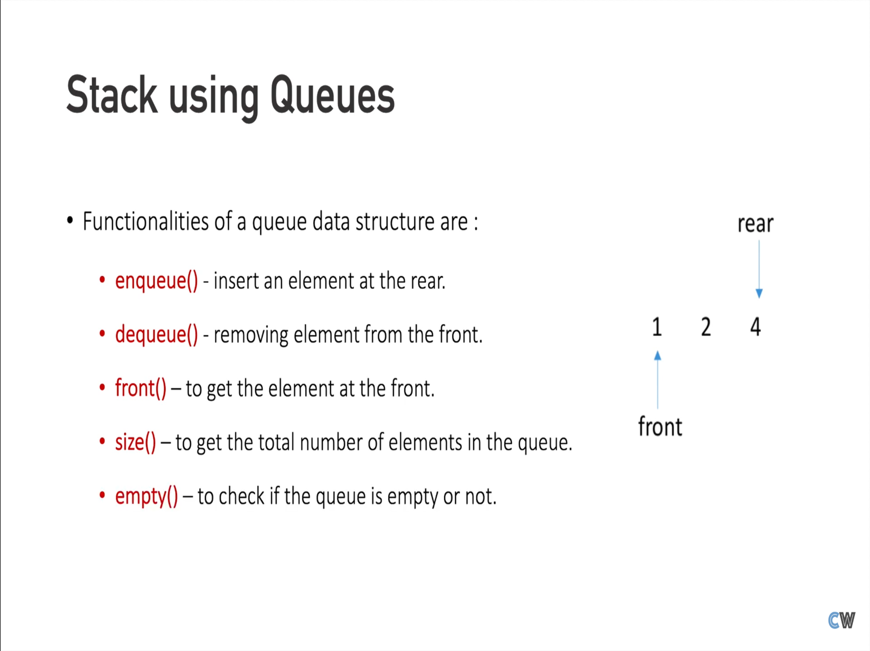

Slide 19
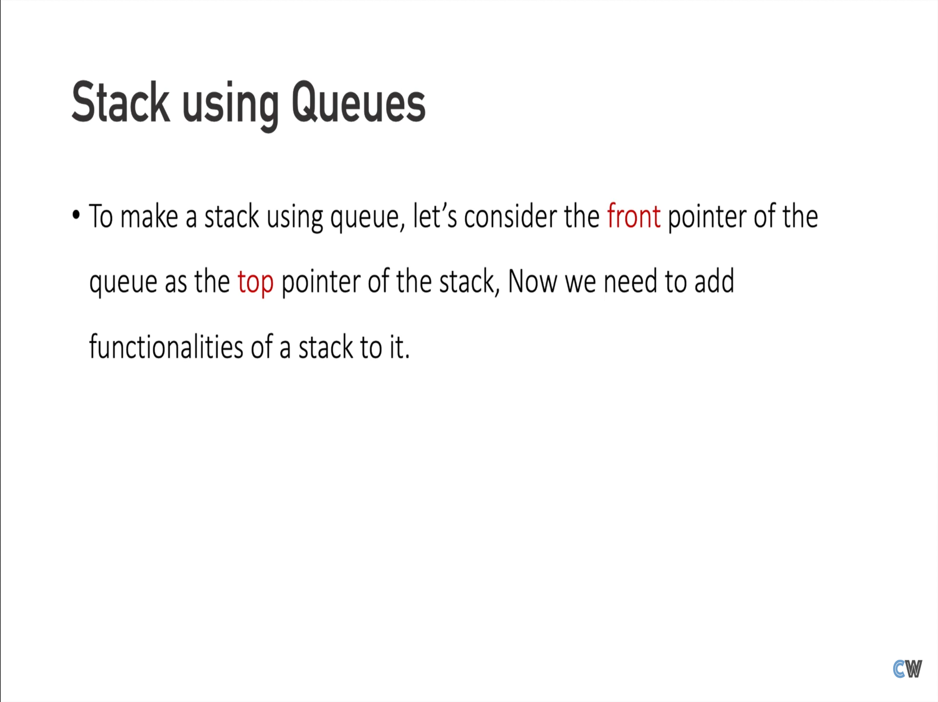

Slide 20
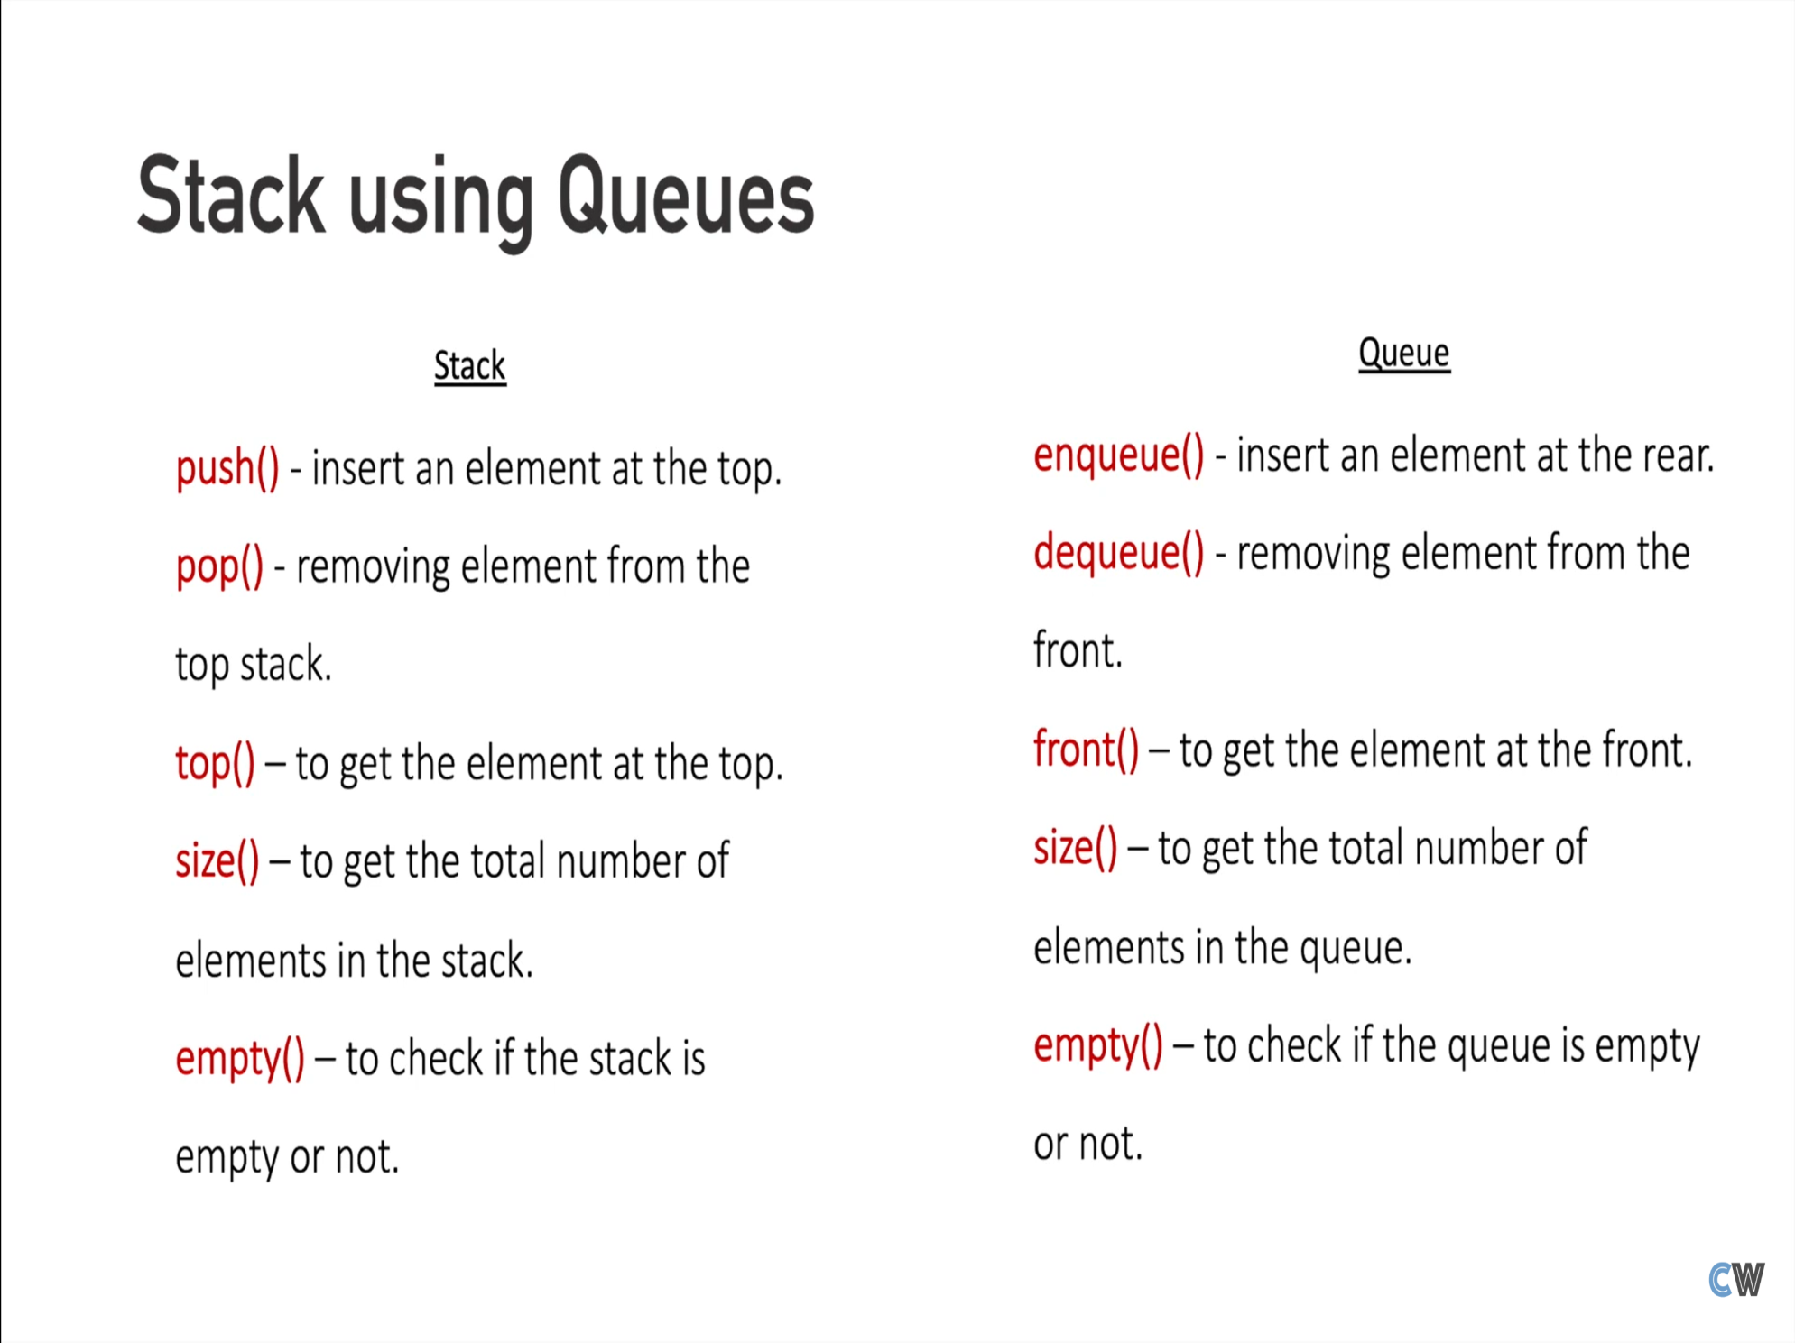

Slide 21
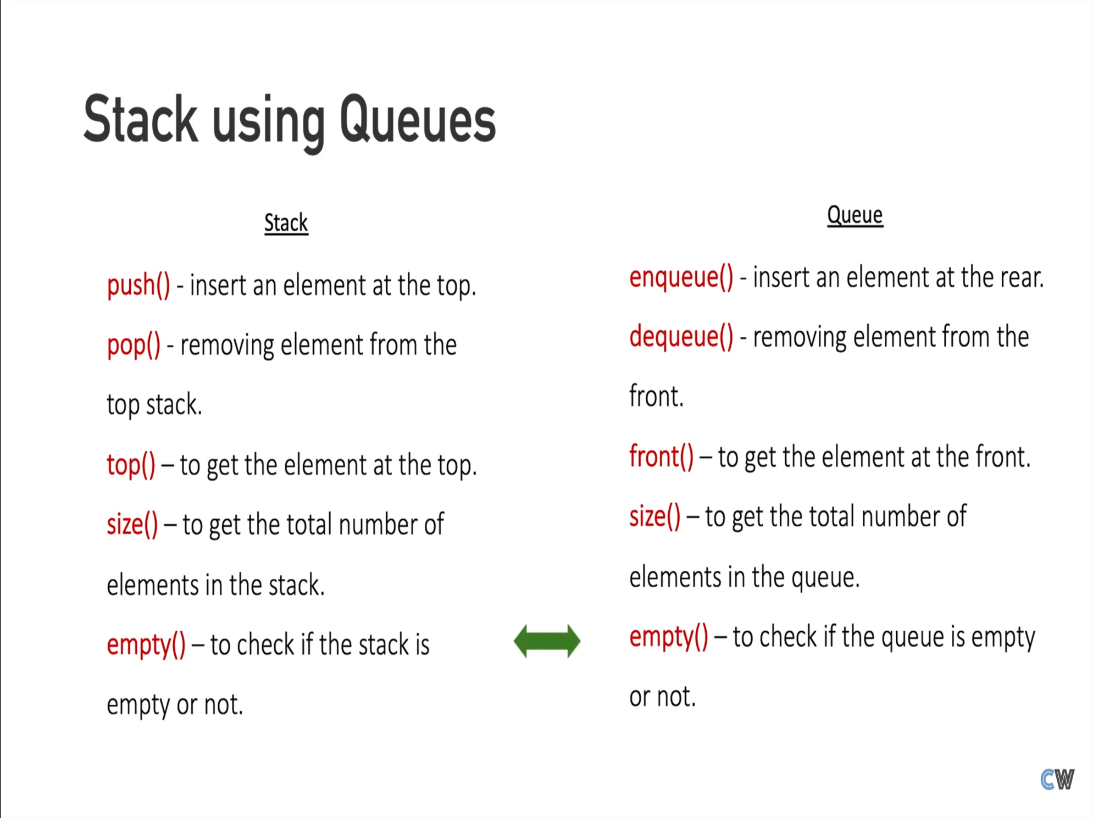

Slide 22
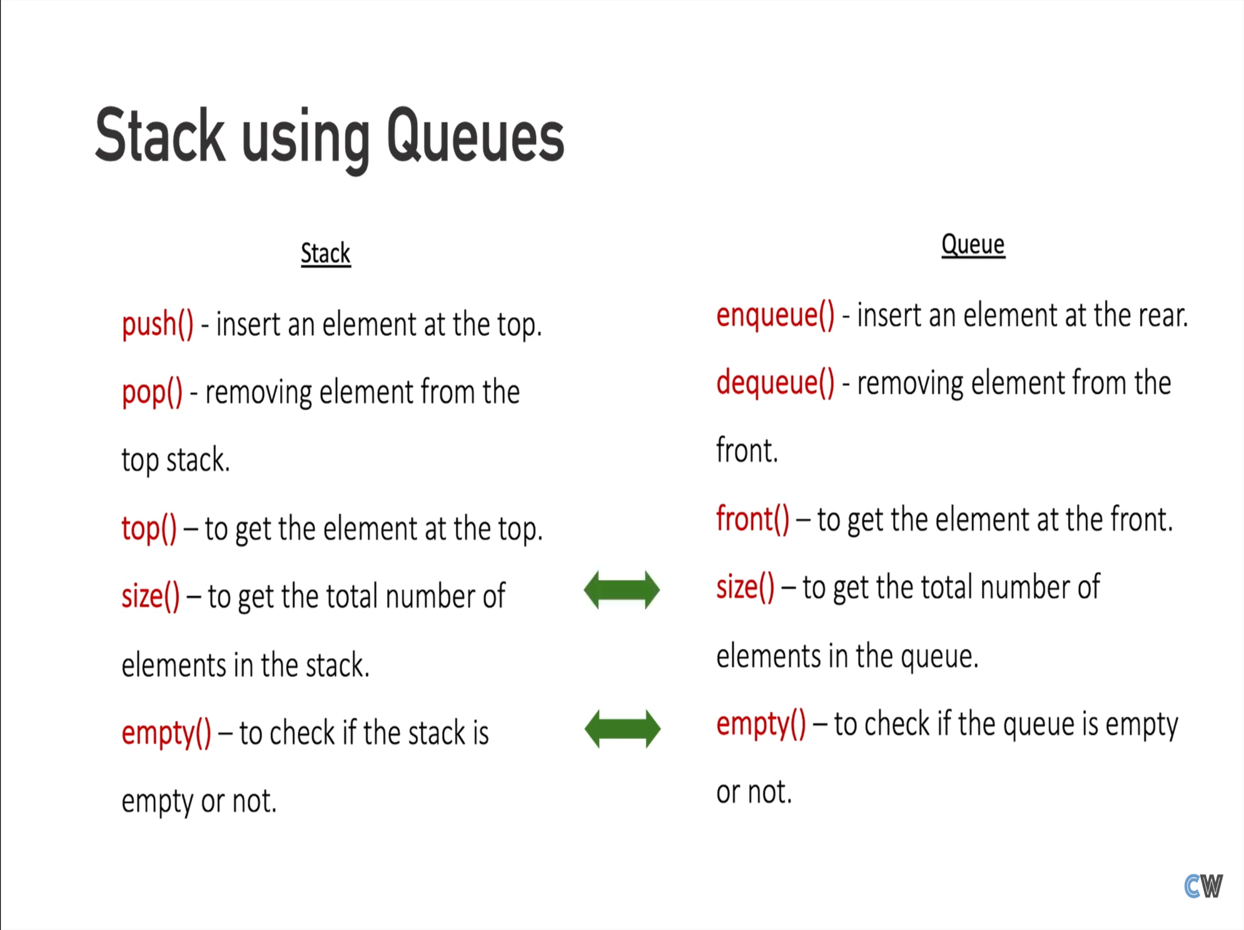

Slide 23
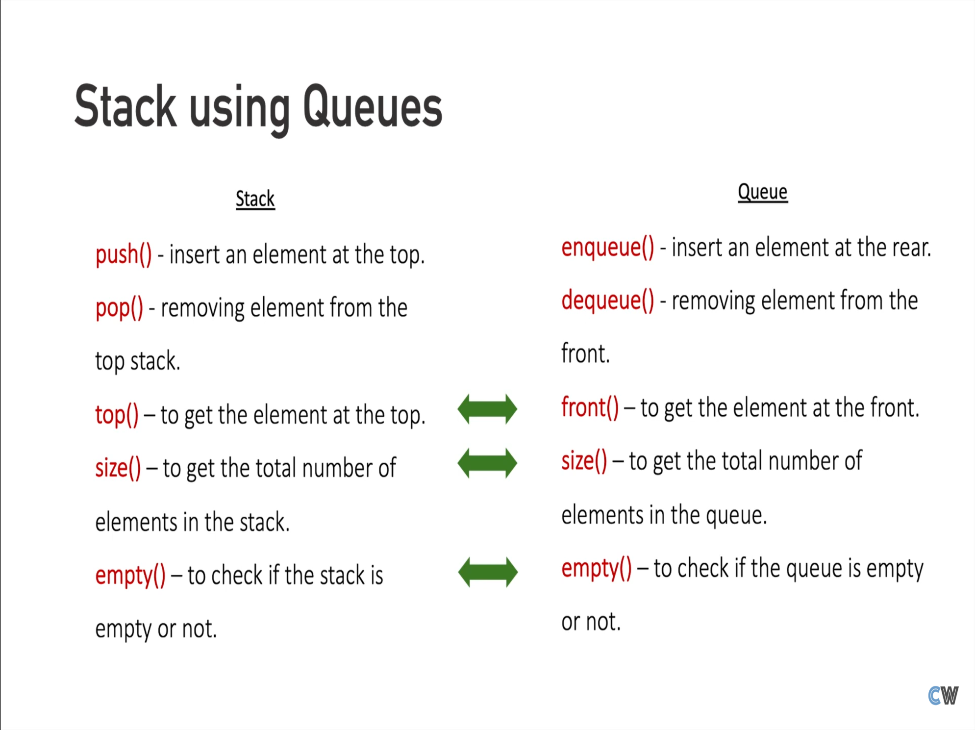

Slide 24
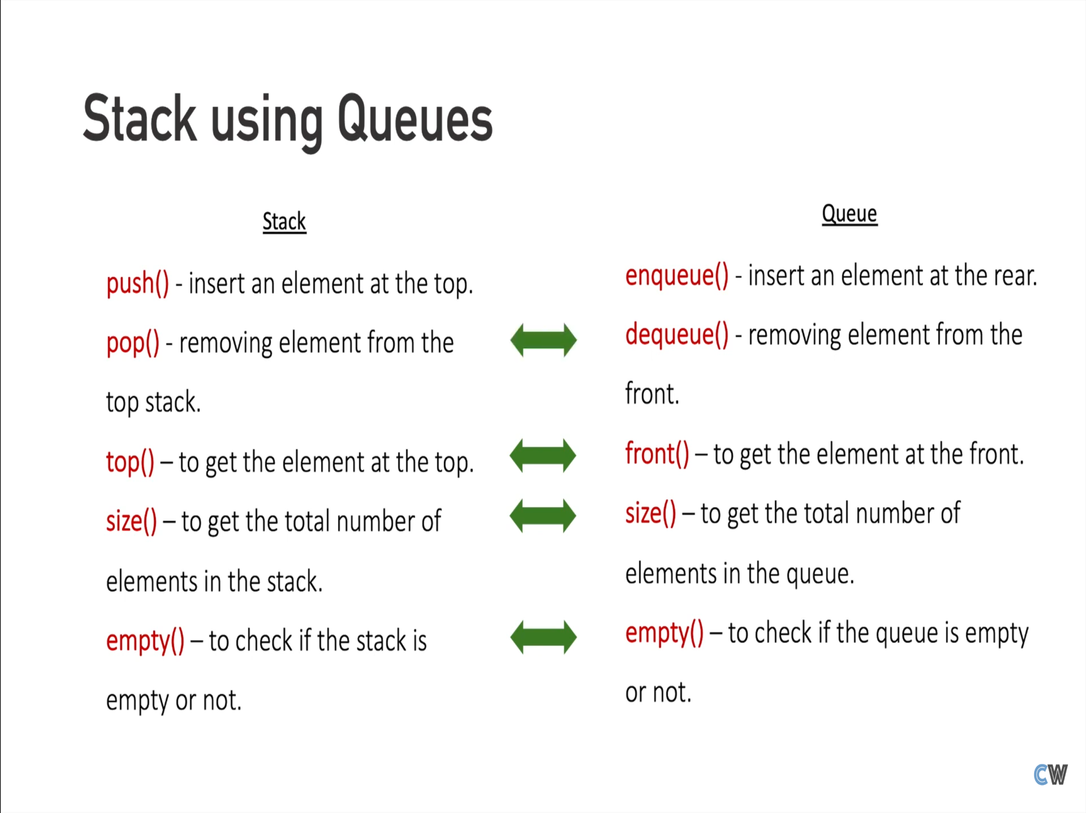

Slide 25
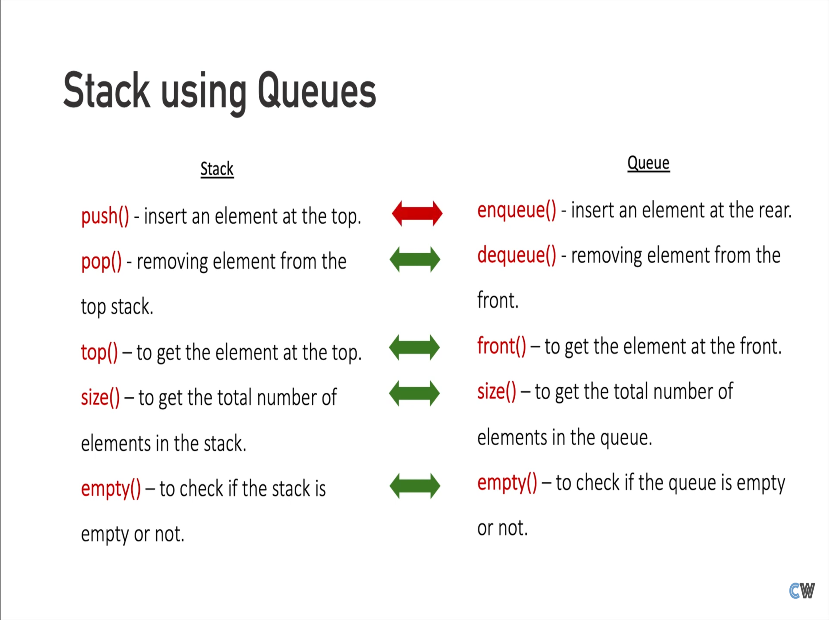

Slide 26
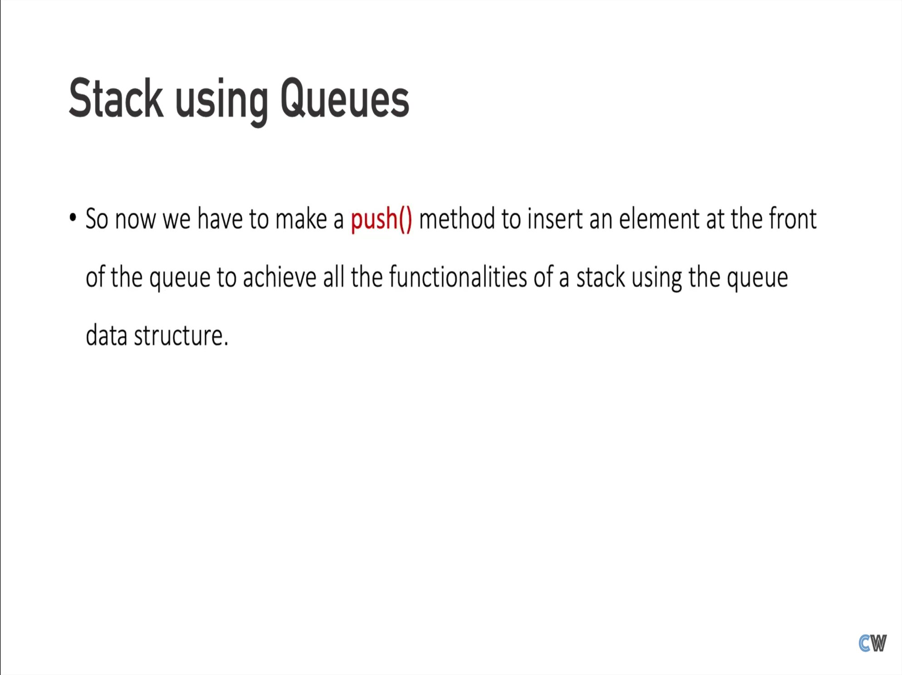

Slide 27
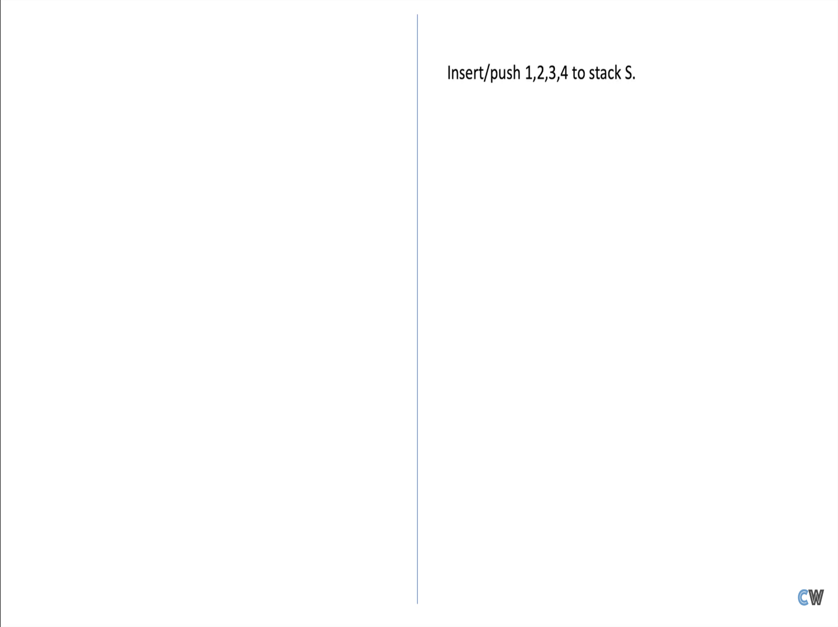

Slide 28
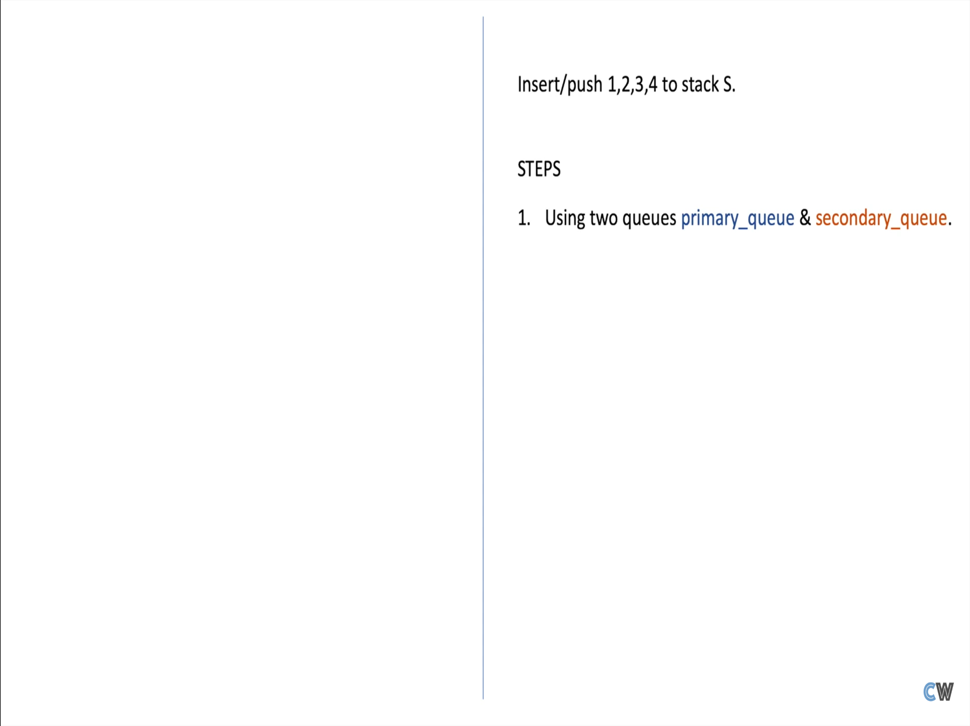

Slide 29
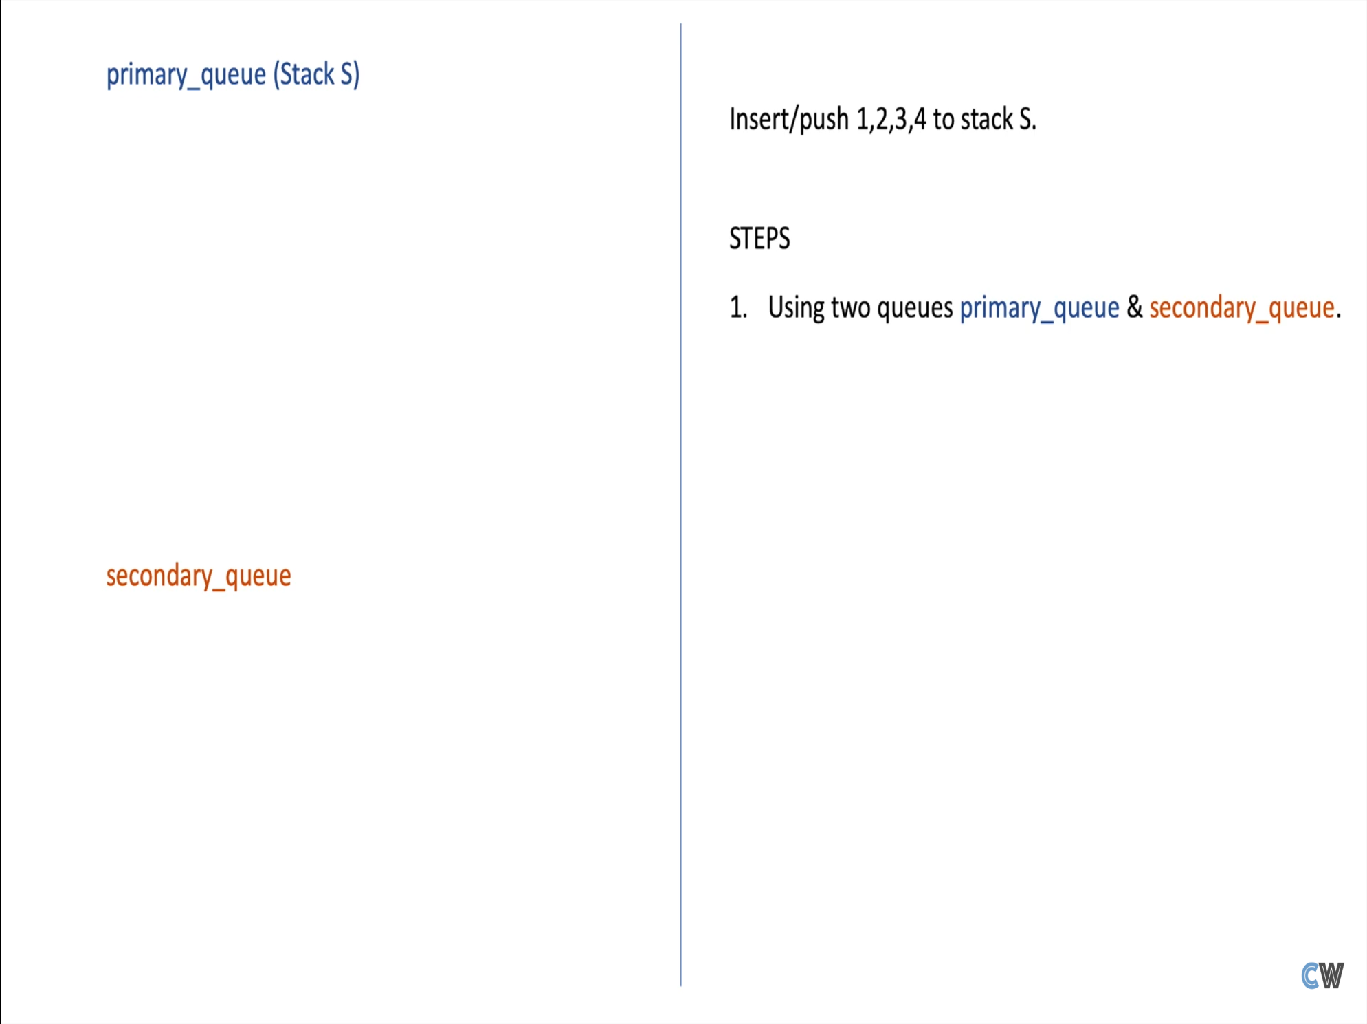

Slide 30
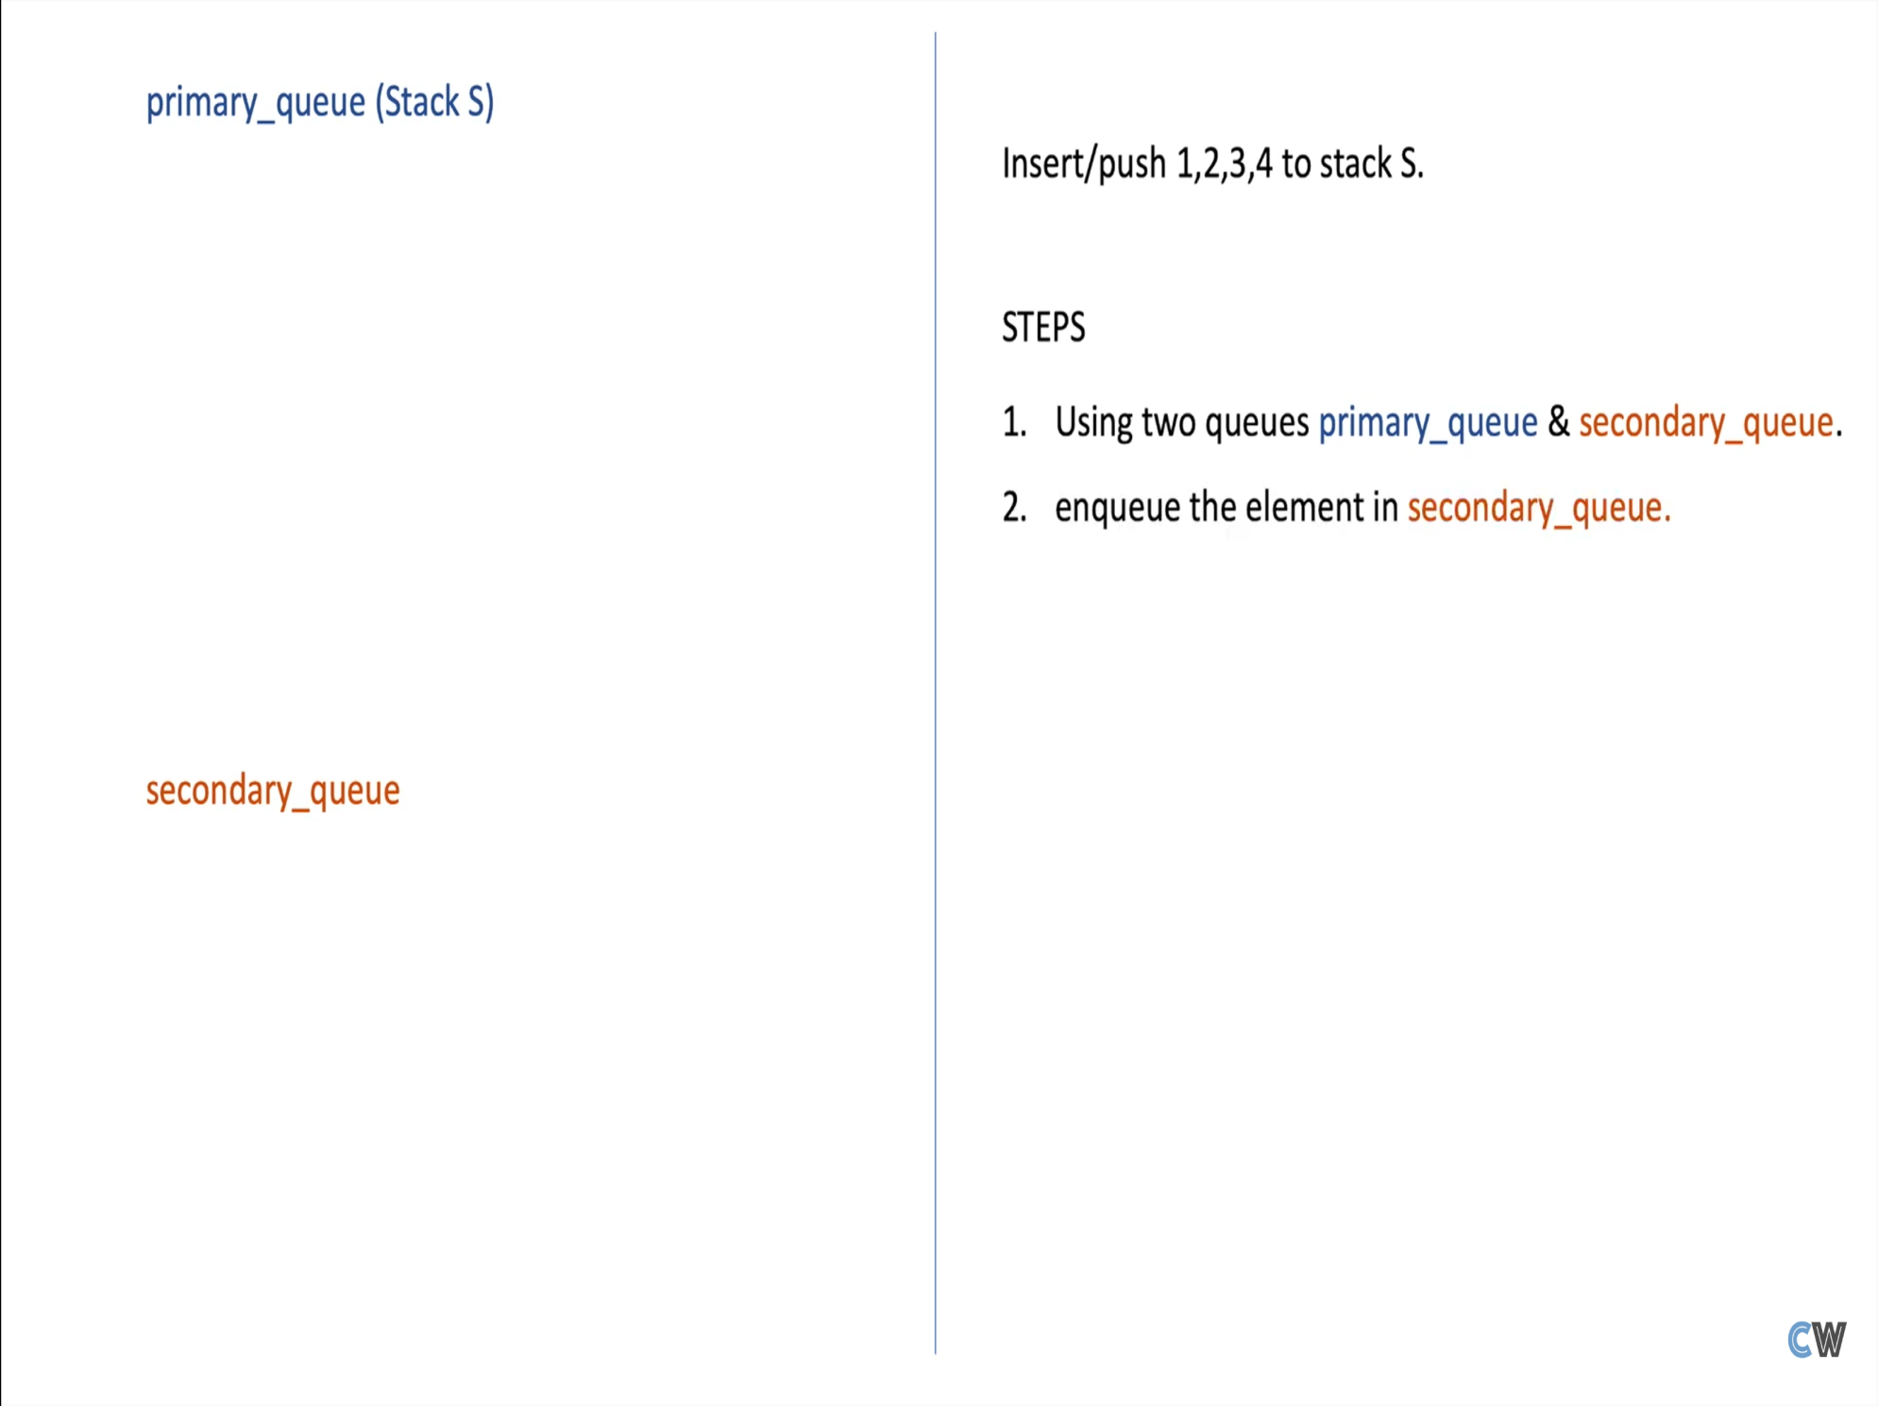

Slide 31
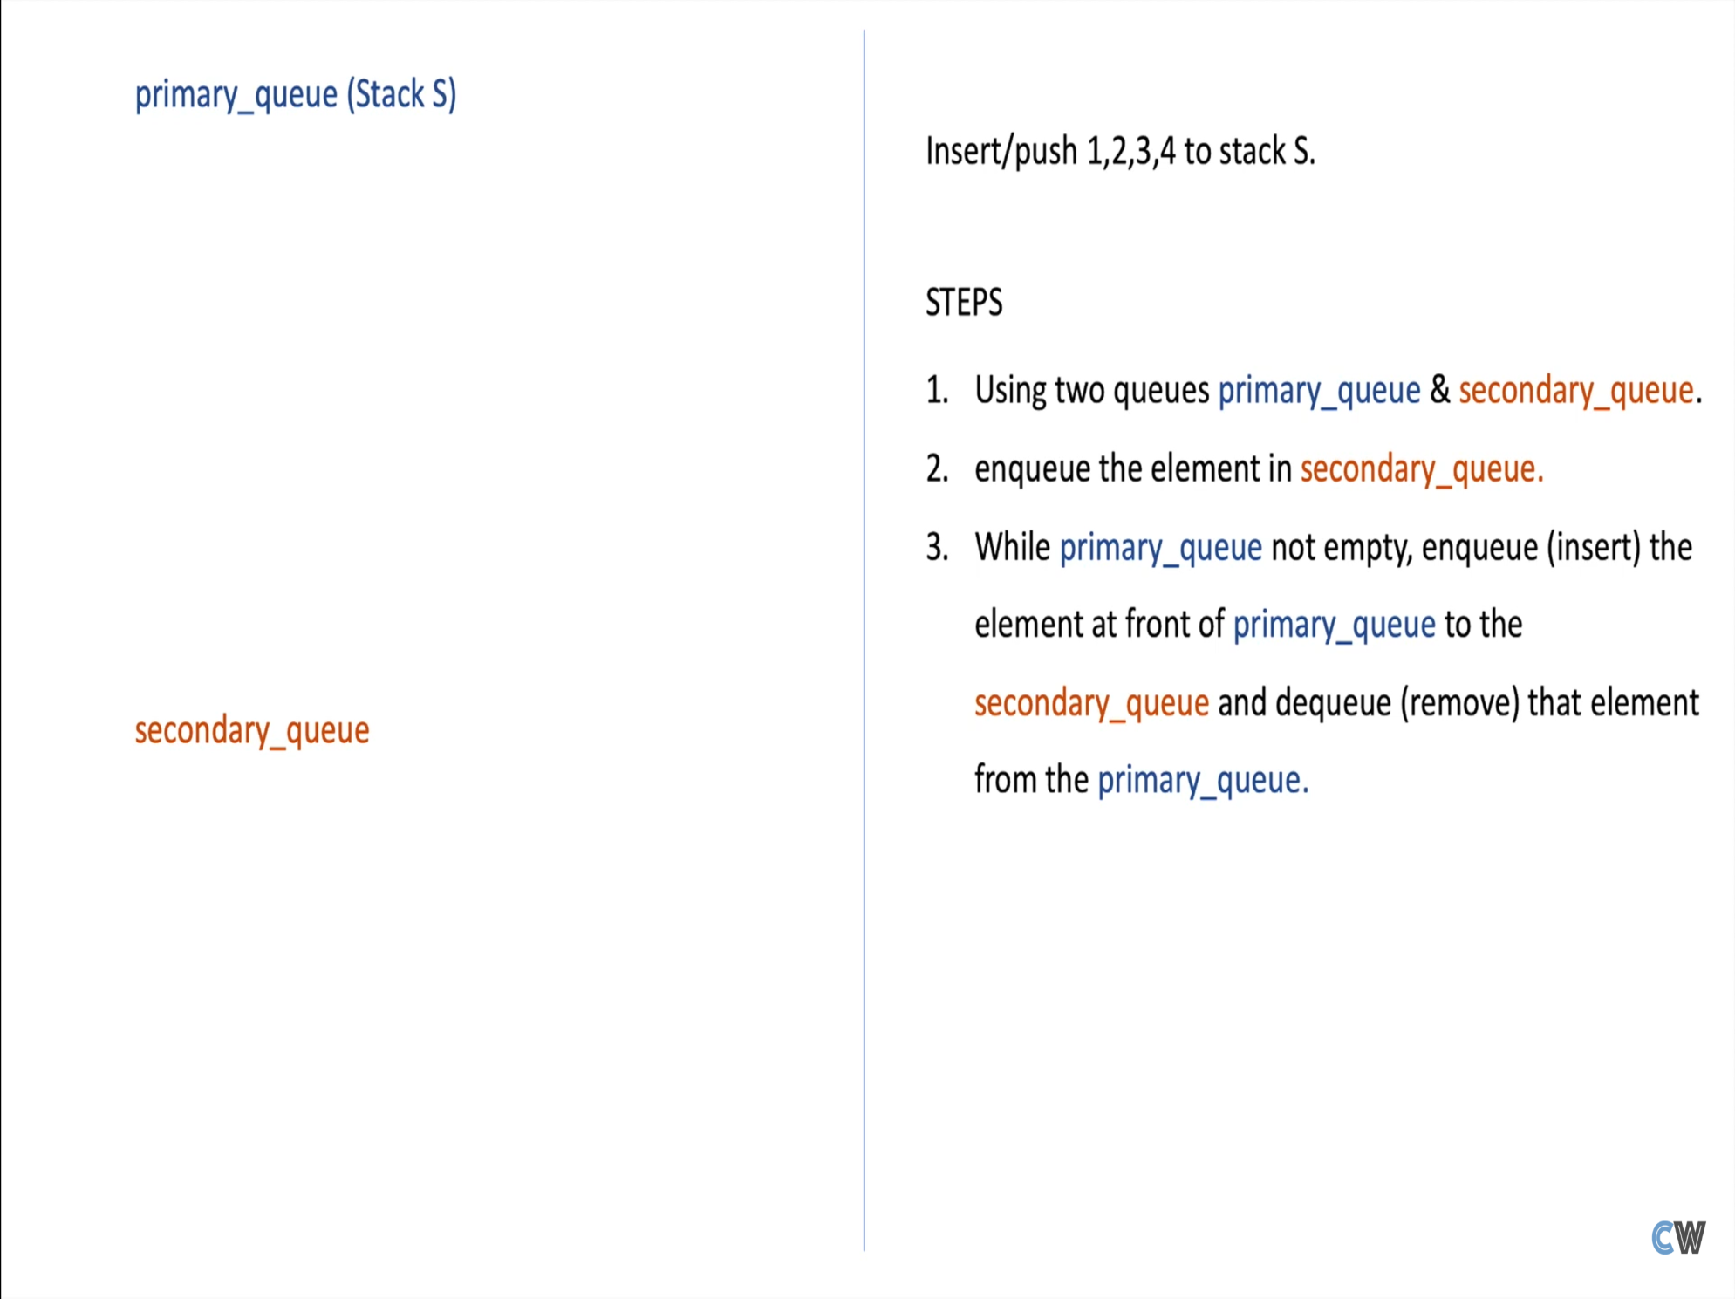

Slide 32
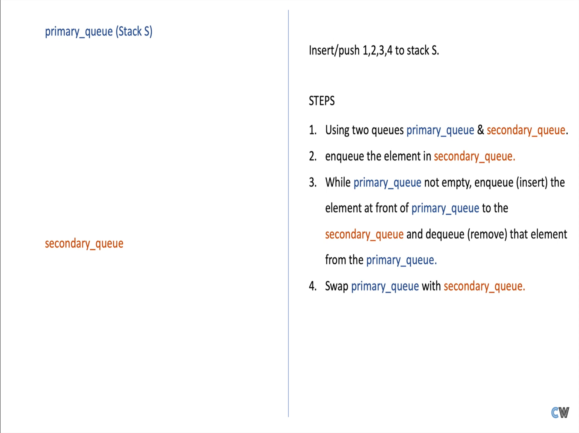

Slide 33
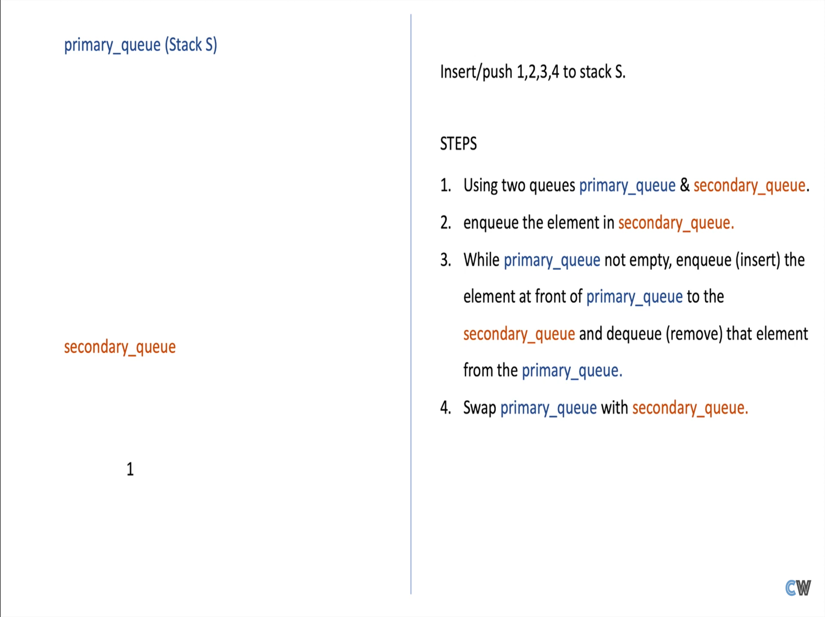

Slide 34
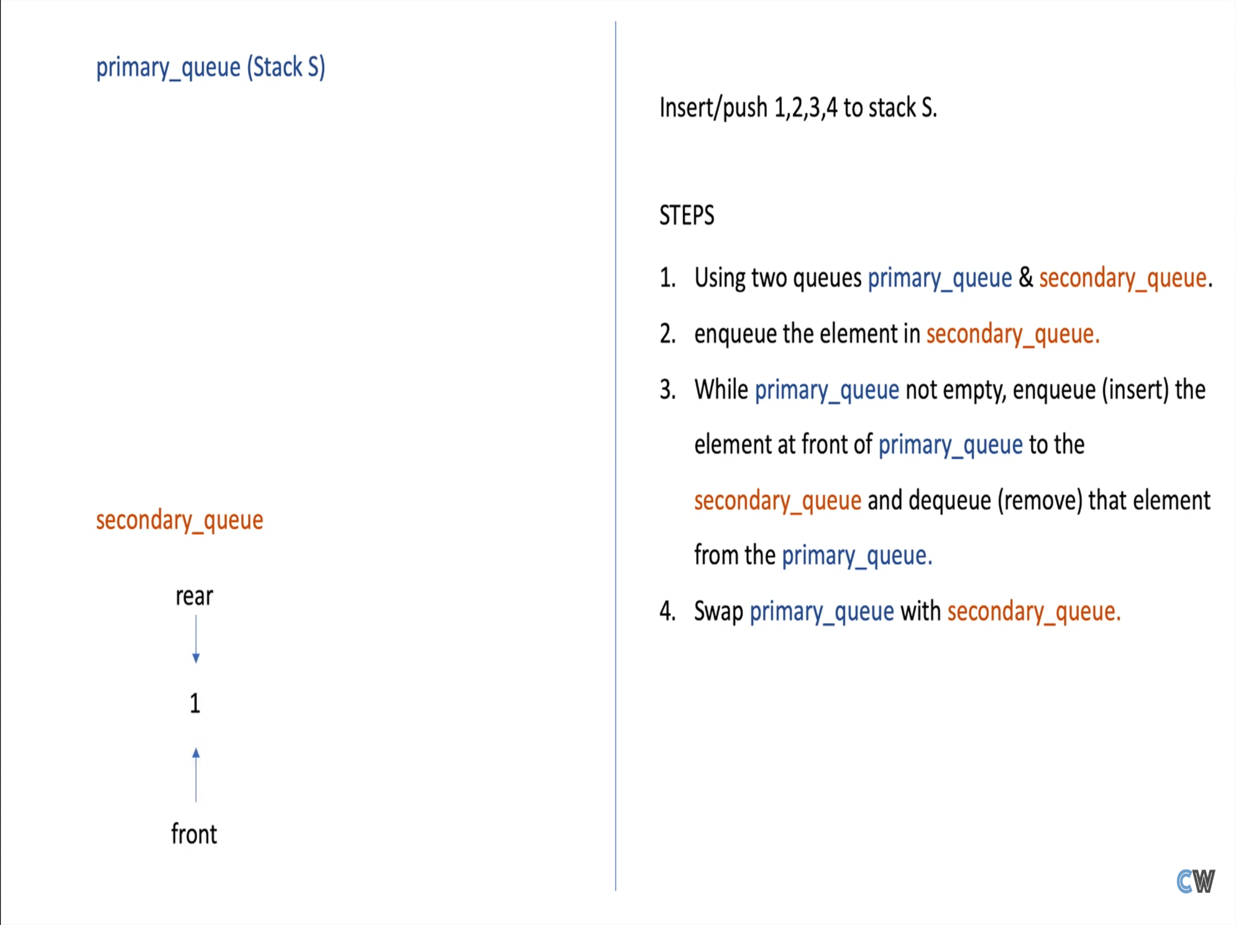

Slide 35
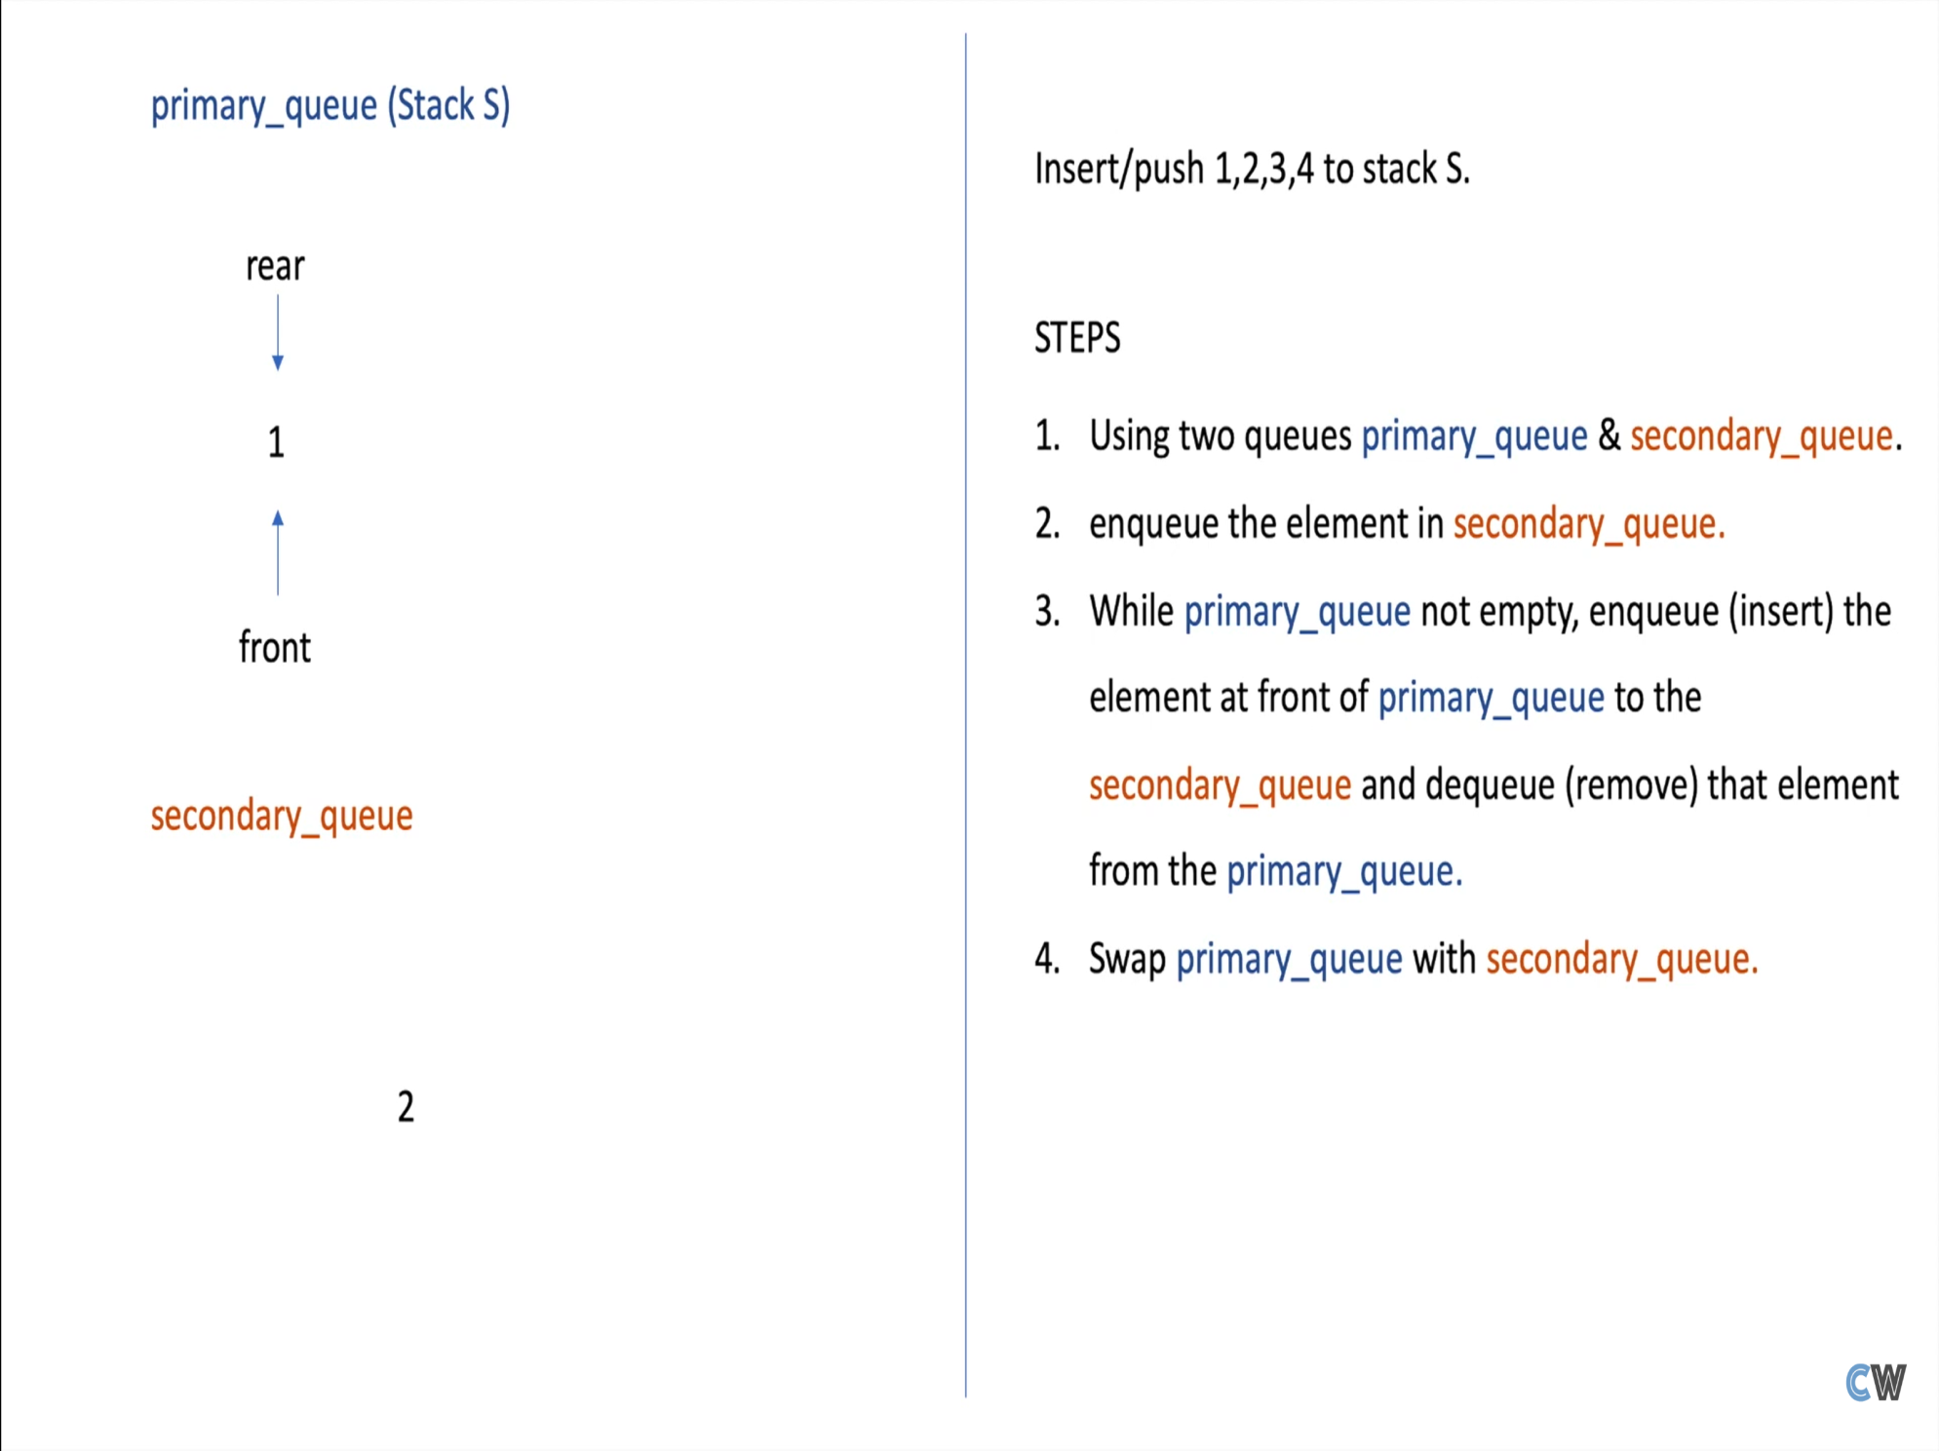



Slide 37
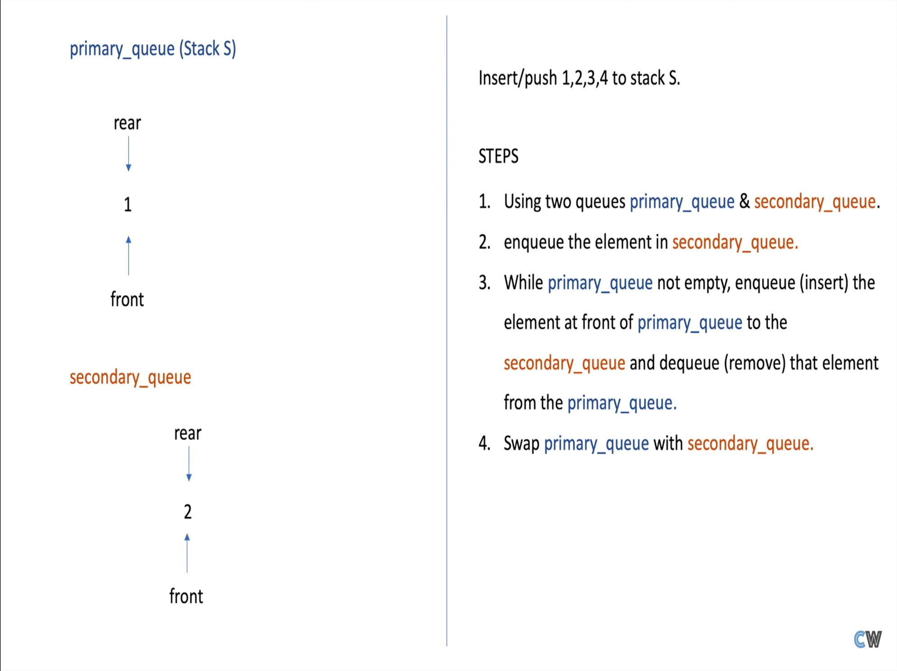

Slide 38
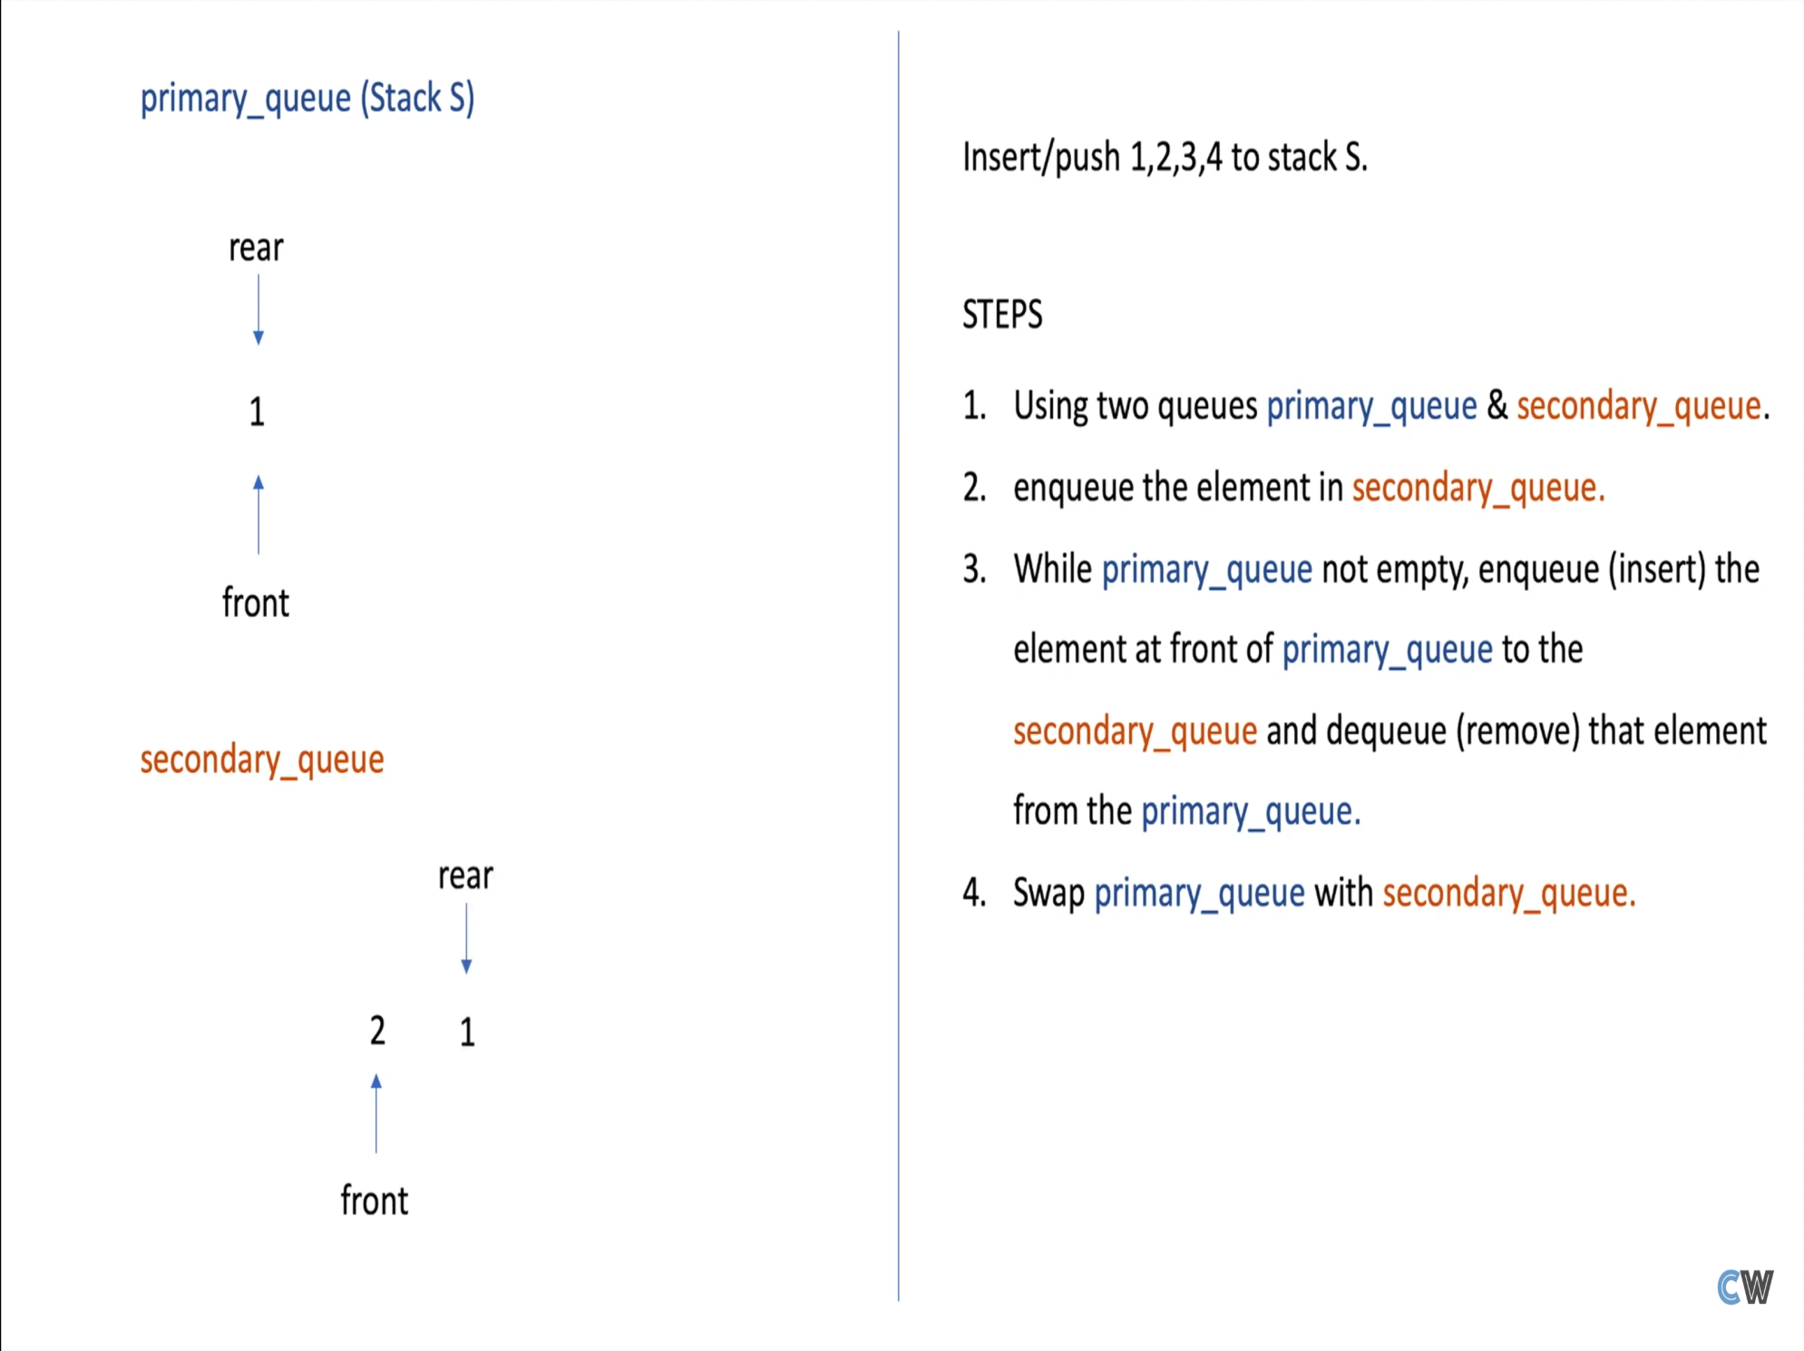

Slide 39


Slide 40
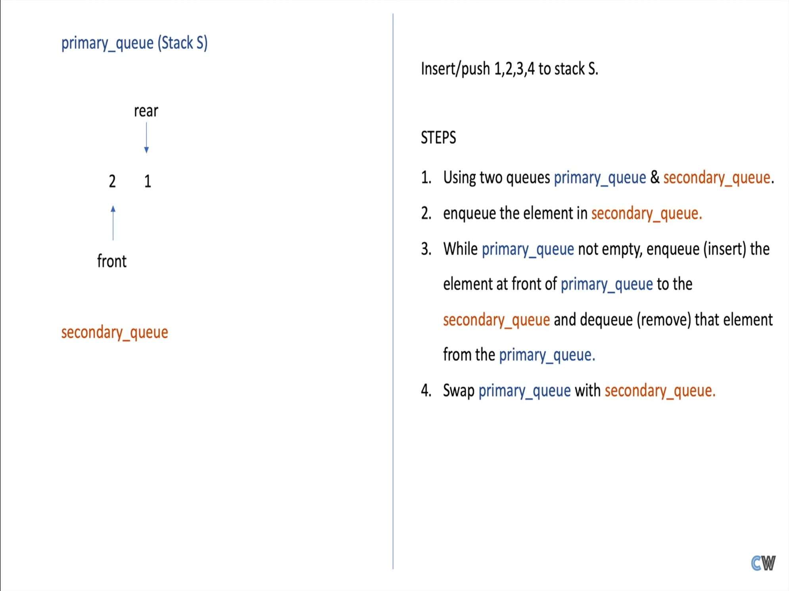

Slide 41
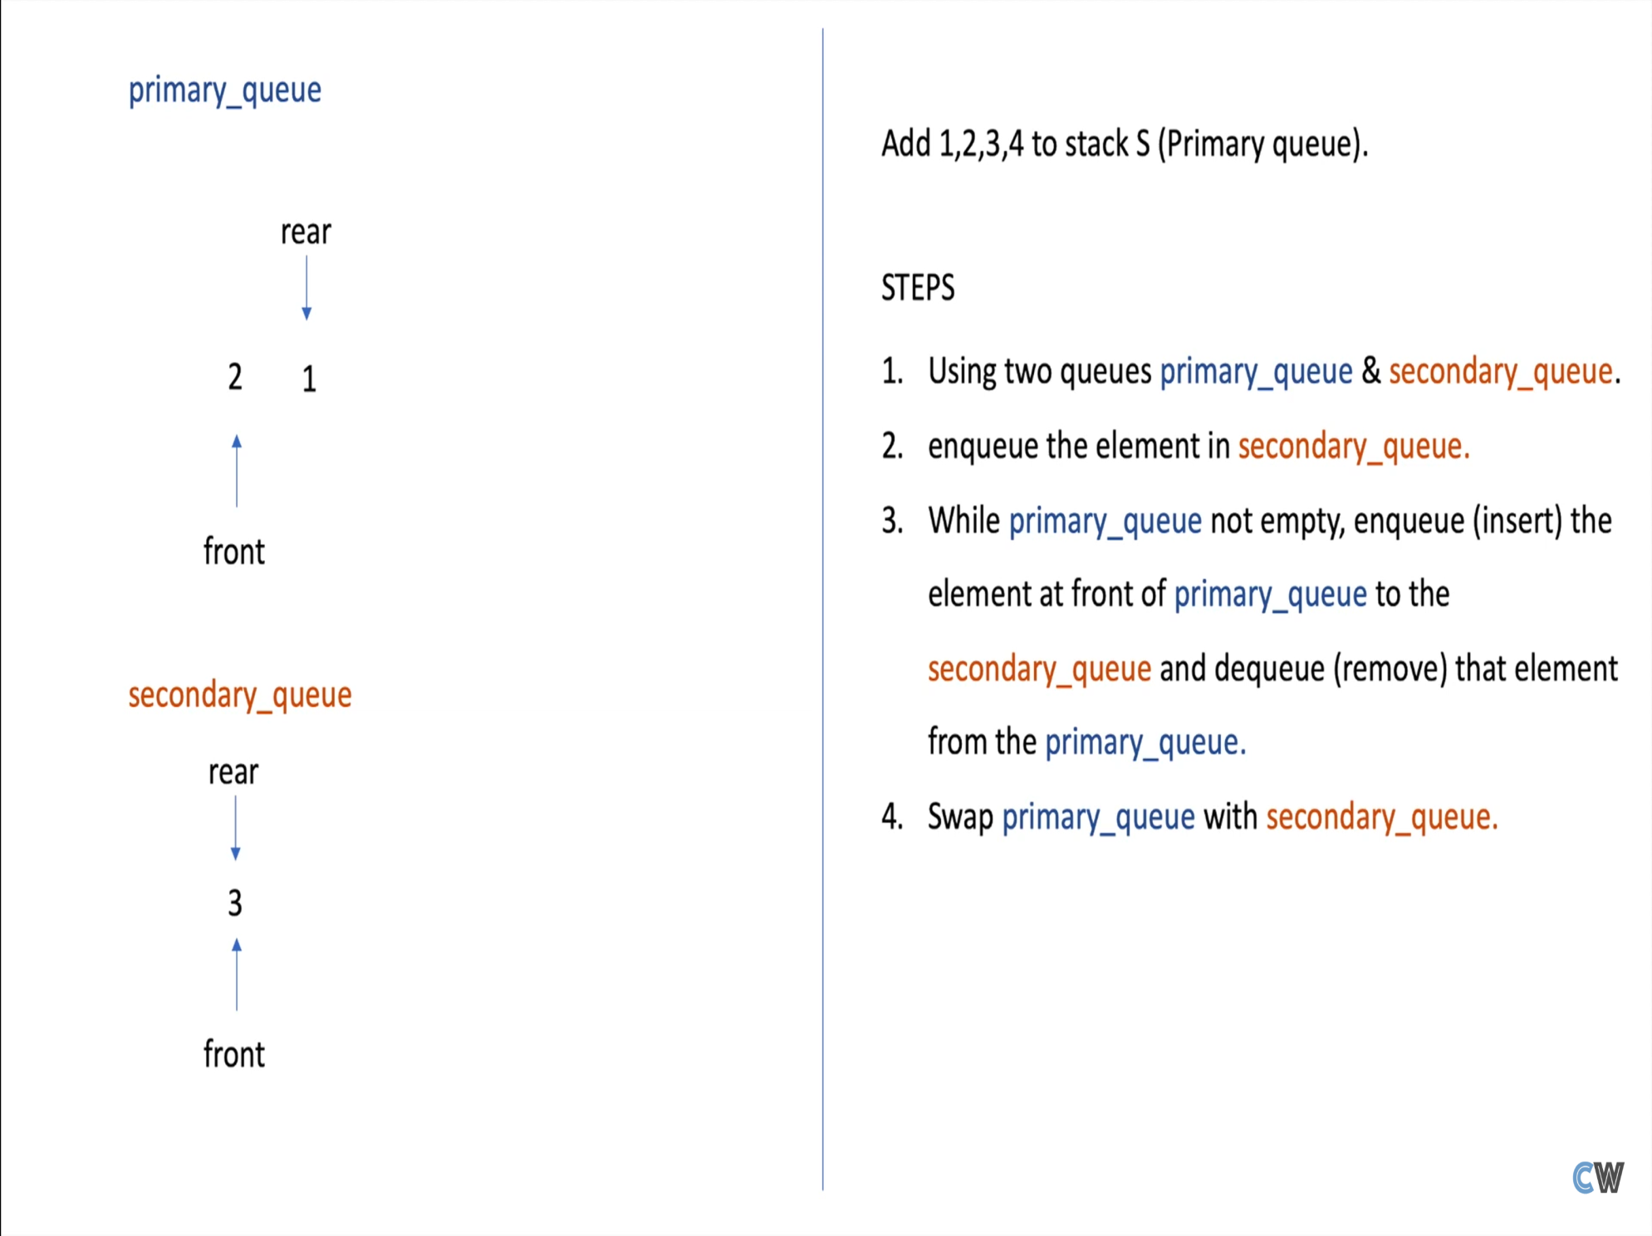

Slide 42
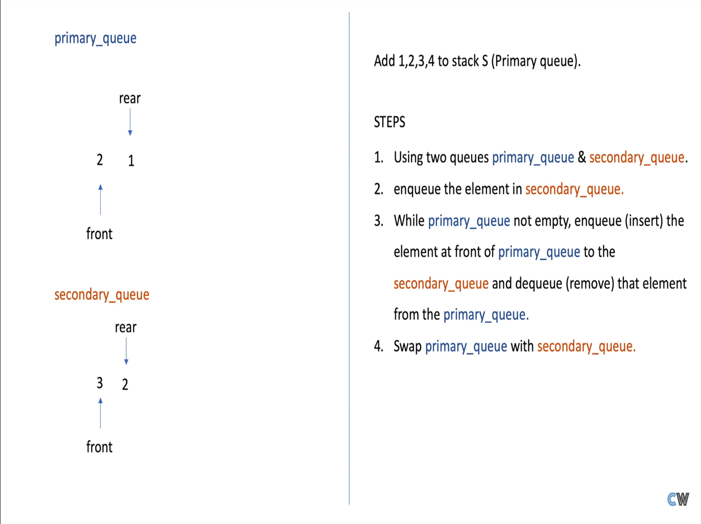

Slide 43


Slide 44
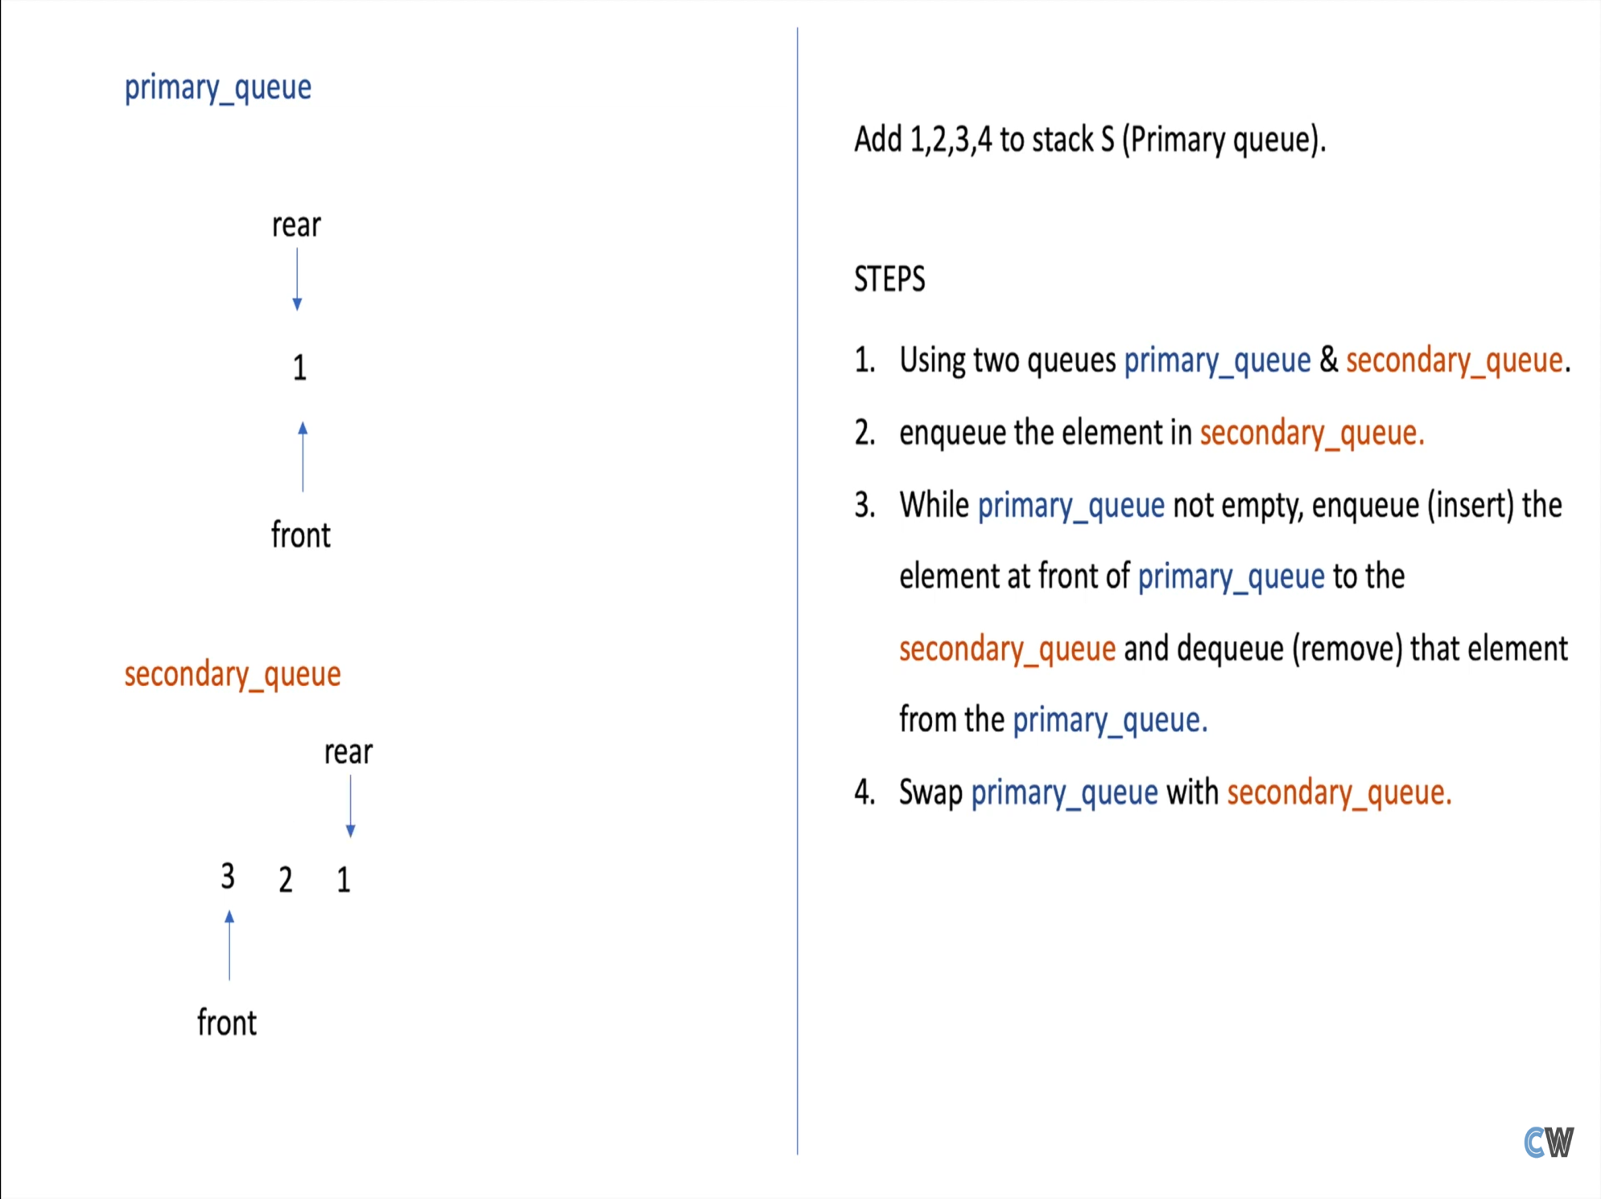

Slide 45
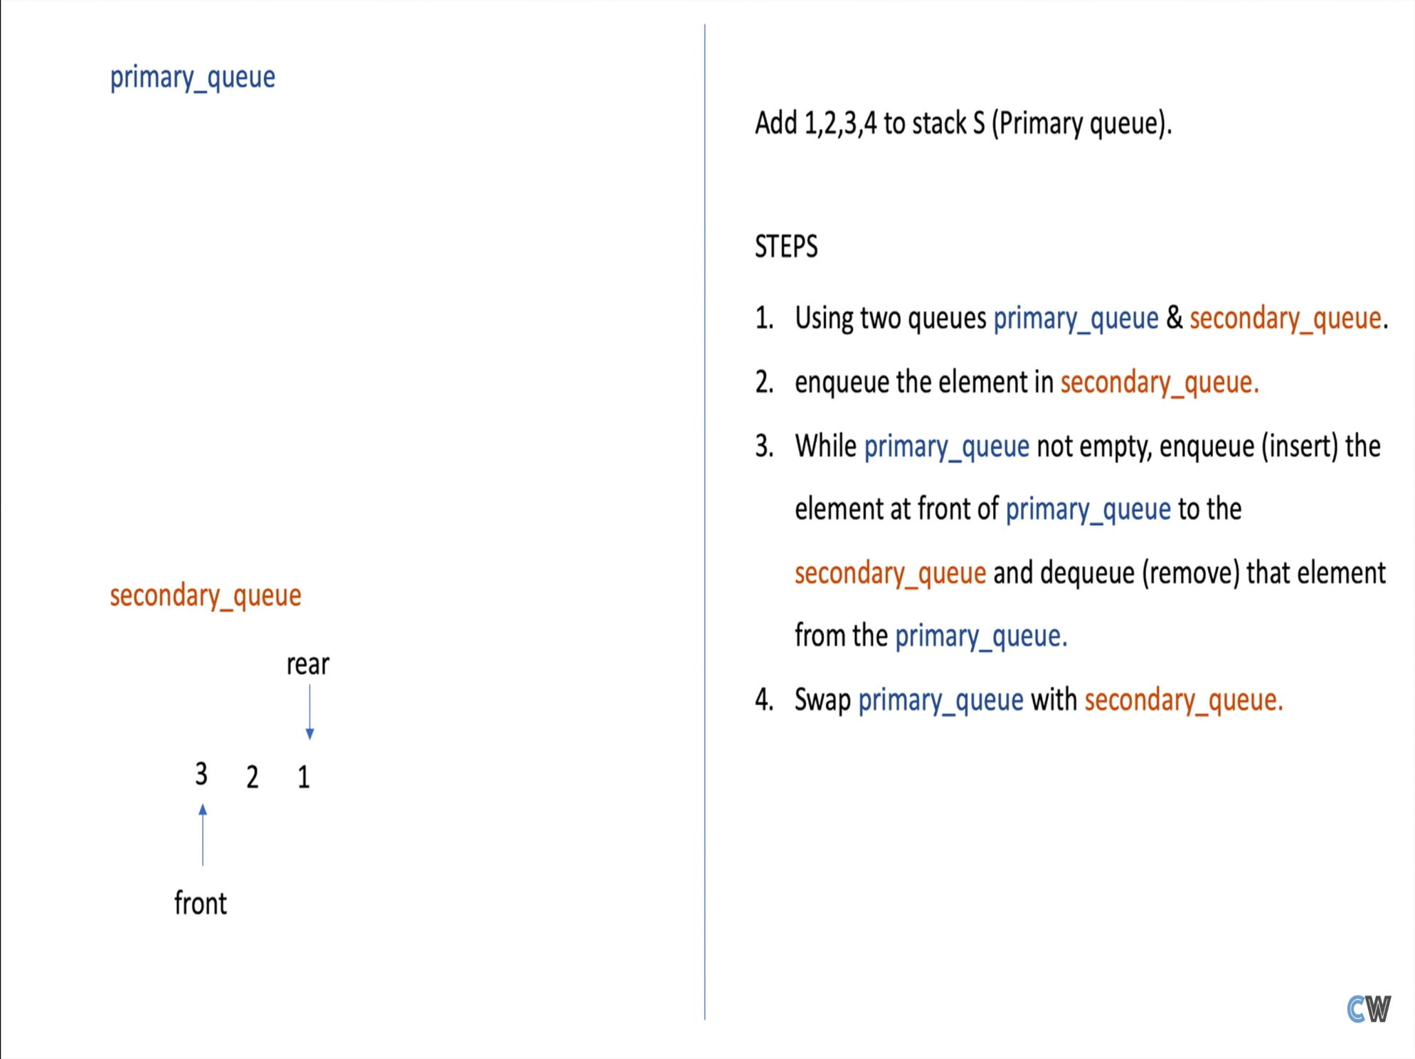

Slide 46


Slide 47
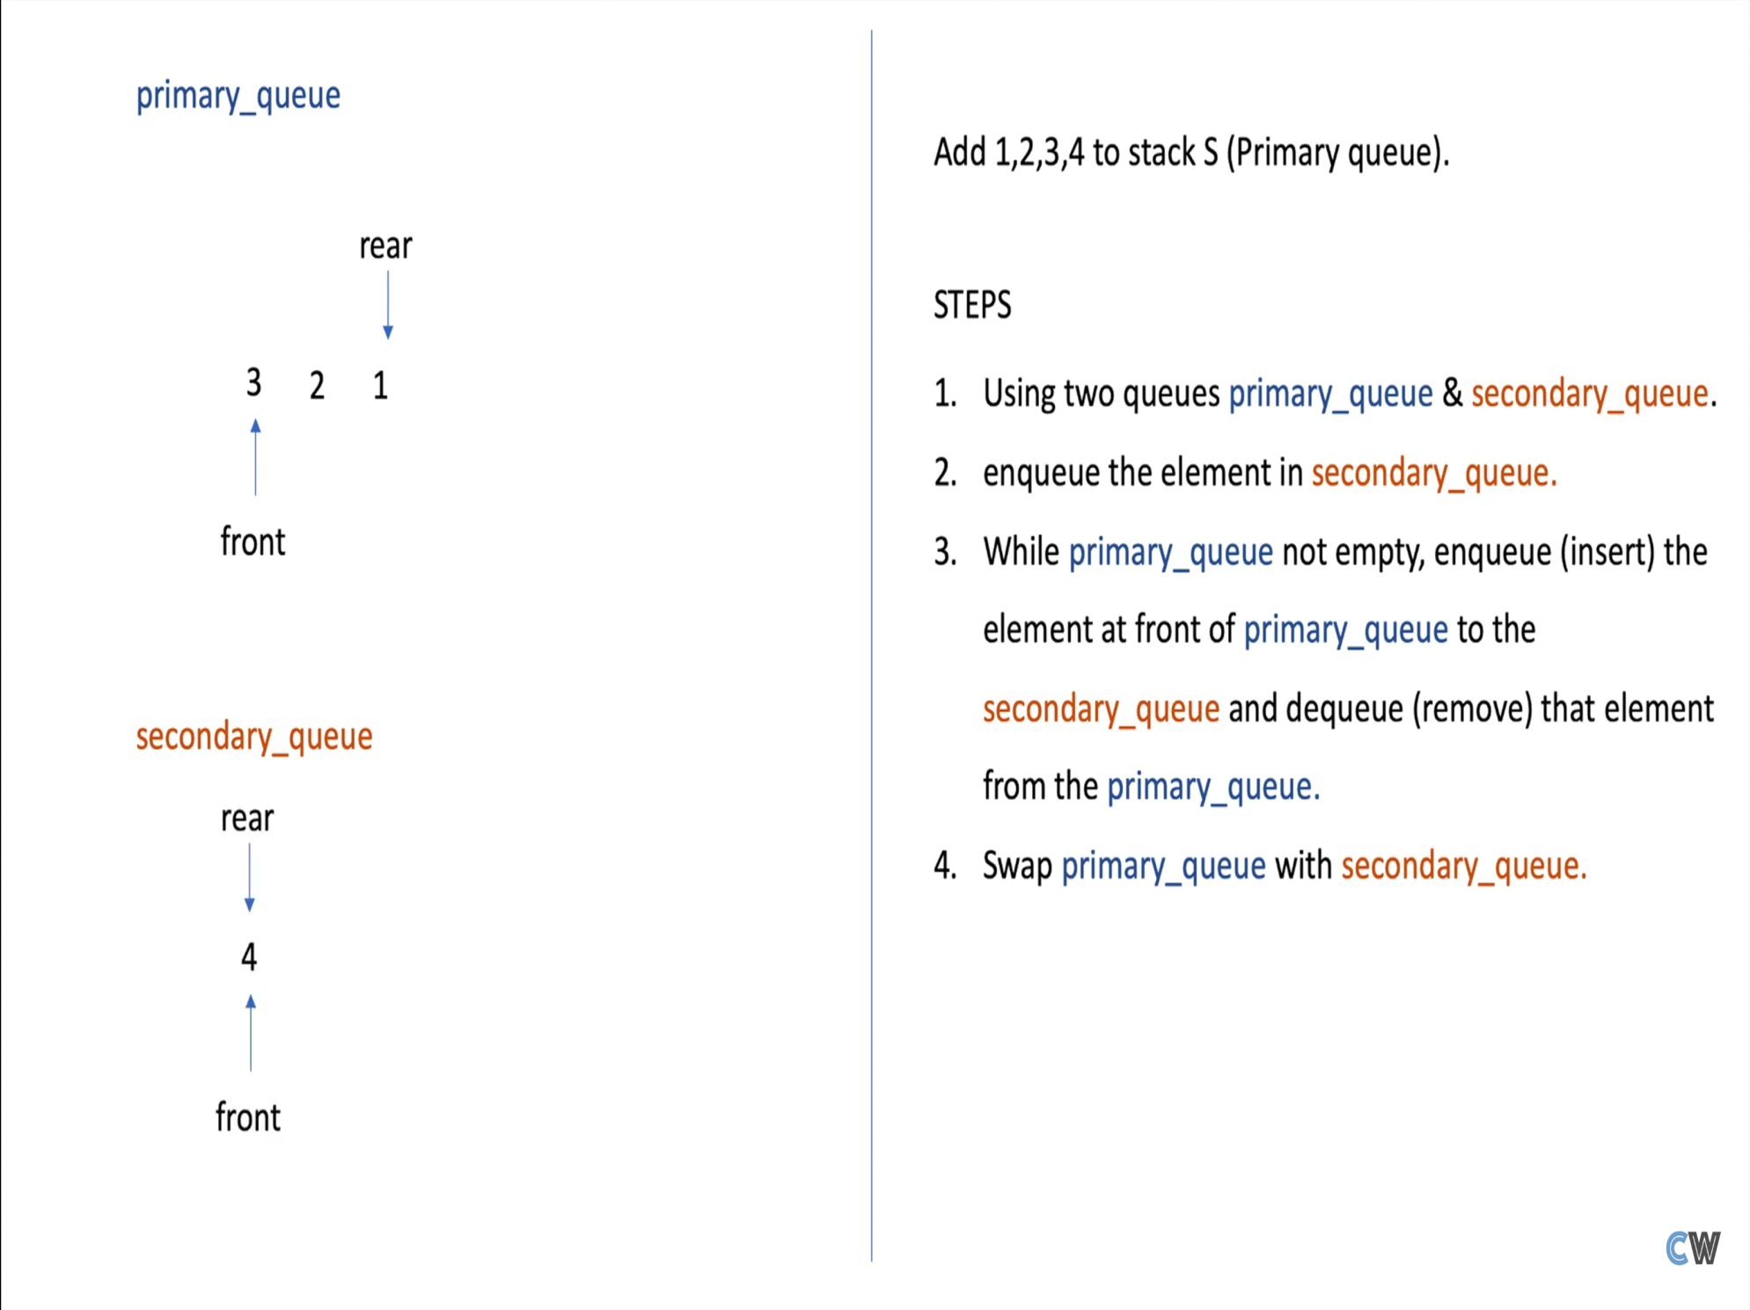

Slide 48


Slide 49


Slide 50


Slide 51


Slide 52
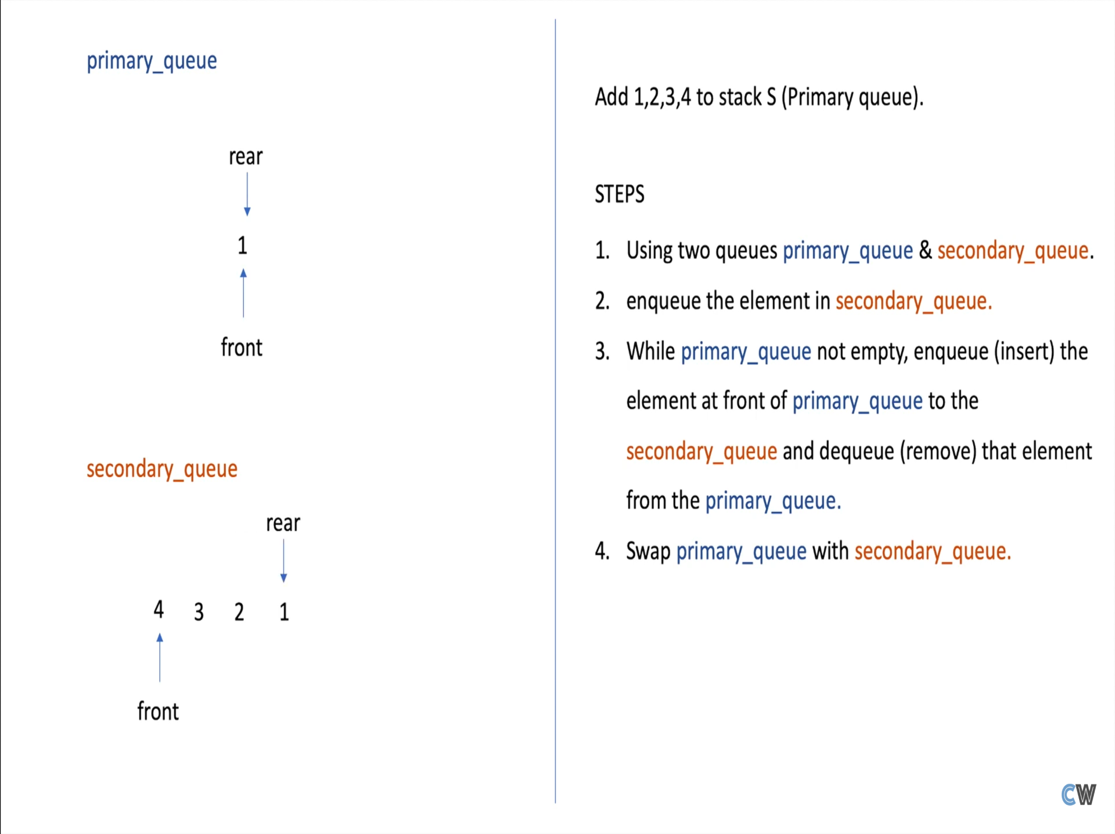

Slide 53
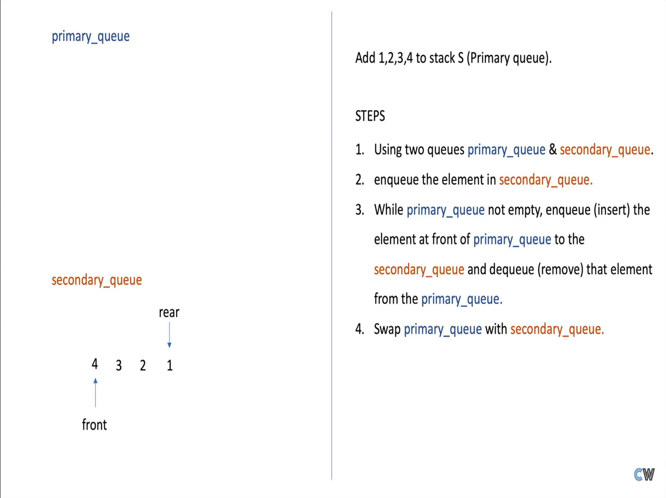

Slide 54


Slide 55
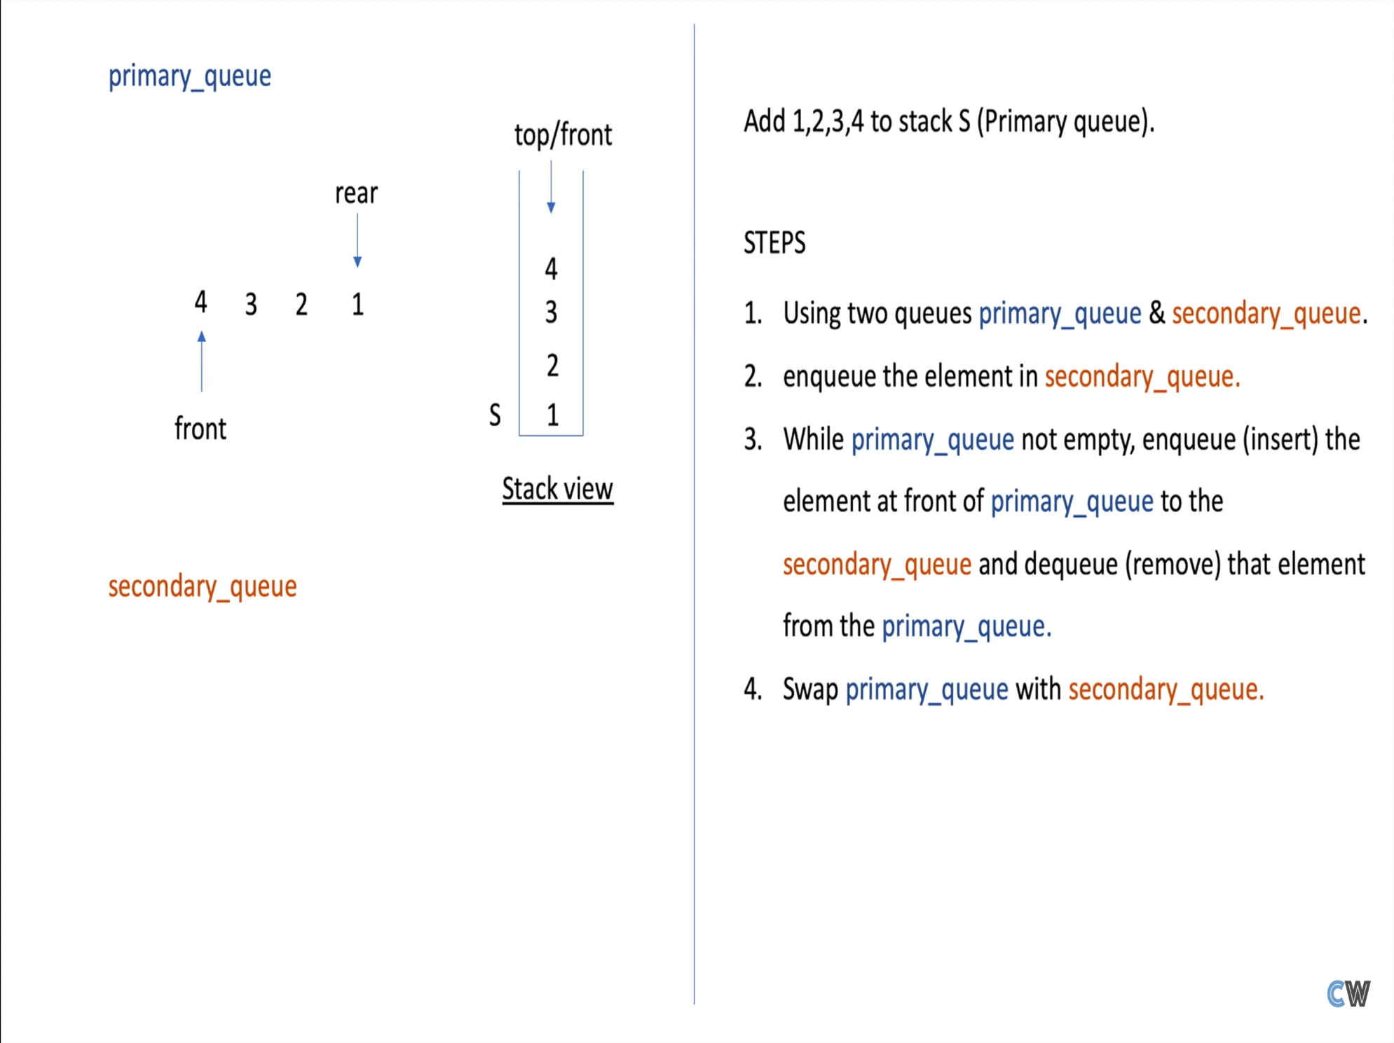

Slide 56
Circular
Queue

Slide 57
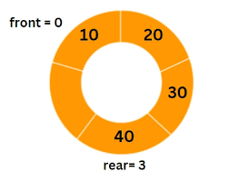
Circular Queue?
The last position is connected to the first position
It is also known as a Ring Buffer.

Slide 58
Why?
If the rear reaches to the end position vacant spaces in the beginning cannot be utilized.
FRONT
REAR
0
1
2
3
4
3
4
5
Dequeue

Slide 59

Implementation using Circular Array
5
0
4
1
3
2
Notes:
© Copyright PresentationGo.com – The free PowerPoint library

Slide 60
Empty?
Rear=-1
Front=-1
5
0
4
1
3
2
Notes:
© Copyright PresentationGo.com – The free PowerPoint library

Slide 61
FULL?
Rear
Rear
Front
Rear
5
0
1=0+1
60
70
10
4
50
Rear
1
Front
20
Rear
40
30
3
2
Rear=-1
Front=-1
Rear
Rear
Notes:
© Copyright PresentationGo.com – The free PowerPoint library

Slide 62
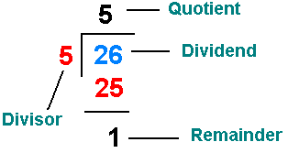
Remainder (%) ?
26 % 5 = ?
“%” is used to keep 'Rear' within the bounds of 'N'

Slide 63
Insertion using %
Rear = (Rear + 1)
% N
“% N” is keeping 'Rear' within the bounds of 'N'
wraps back to 0 when it reaches 'N'
This line is essential for implementing Circular Queue.
Notes:
© Copyright PresentationGo.com – The free PowerPoint library

Slide 64
Example:
Rear
Rear
Rear
Front
5
0
60
70
10
4
50
Rear
1
20
Rear
Front
40
30
3
2
Rear=-1
Front=-1
Rear
Rear
Notes:
© Copyright PresentationGo.com – The free PowerPoint library

Slide 65
Enqueue Function:
isFull then return
If (front && rear == -1) then front = rear = 0
else rear = (rear + 1) % N

Slide 66
Dequeue Function:
isEmplty then return
If (front == rear) then front = rear = -1
else front= (front+ 1) % N

Slide 67
Deque
A brief introduction Deque with implementation

Slide 68
What is a Deque (or double-ended queue)
Deque is a linear data structure where the insertion and deletion operations are performed from both ends
insertion
insertion
deletion
deletion
Representation of Deque

Slide 69
Types of deque
There are two types of deque
Output restricted queue
Input restricted queue

Slide 70
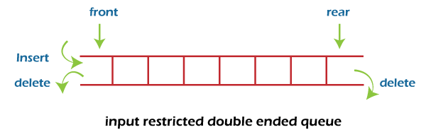
Input restricted Queue
insertion operation can be performed at only one end
deletion can be performed from both ends

Slide 71
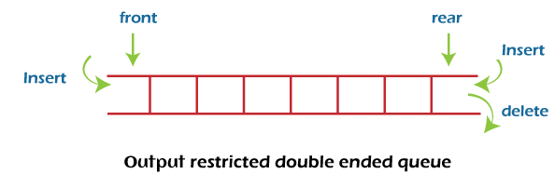
Output restricted Queue
Deletion operation can be performed at only one end
Insertion can be performed from both ends

Slide 72
Operations performed on deque
Insertion at front
Insertion at rear
Deletion at front
Deletion at rear

Slide 73
Full Queue
Empty Queue
Check
((front == 0 && rear == n - 1) OR (front == rear + 1))
Return true
Check
Front == -1
Return true

Slide 74
Insertion at the front end
check if Full then return
if front == -1 then front = rear = 0
If front == 0, then front = n-1 (last index)
Else, Front--.
Add the new element into array[front]
0
1
2
3
4
10
11
12
13
14
front
rear

Slide 75
Deletion at the front end
If front = -1 (underflow)
If only one element (front=rear), set front = -1
and rear = -1
Eles if front is at the end (front = n-1) then
front = 0
Else, Front++
0
1
2
3
4
10
11
12
13
14
front
rear

Slide 76
Deletion at the rear
If deque is empty (front = -1) (underflow)
If only one element (front = rear), set front = -1
and rear = -1
Else, if rear is at the front (rear = 0), set go to
the front rear = n-1
Else rear--
0
1
2
3
4
10
13
14
front
rear

Slide 77
Application
Applied as both stack and queue, as it supports both operations.
Storing a web browser’s history.
Storing a software application’s list of undo operations.
Job scheduling algorithm

Slide 78
Priority
Queue

Slide 79
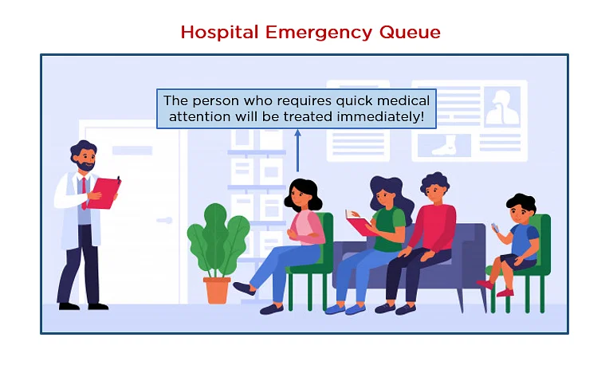
Priority Queue
A priority queue is a type of queue that arranges elements based on their priority values

Slide 80
Priority Queue
Ascending Queue
Descending Queue
1
3
5
55
96
96
55
5
3
1

Slide 81
Operation on Priority Queue
Adding
Removing
Peek

Slide 82
Implementation Of Priority Queue
Linked-list
Array
Heap
Binary Search Tree
Mostly Programmer used this method

Slide 83
Implementation of PQ using heap
Heap:
A Heap is a special Tree-based data structure.
Heap is a binary tree data structure.
A heap is typically represented in array.

Slide 84
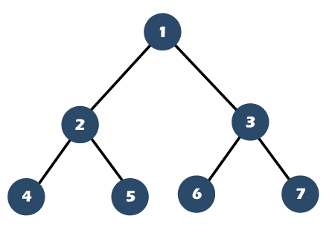

Difference
Complete Binary Tree
Incomplete Binary Tree

Slide 85

Visualisation:
A
B
C
D
E
F
G
Implement:
0
1
2
3
4
5
6
Formula:
Left(i) = 2i + 1
Right(i) = 2i + 2
Parent(i) = i-1
2

Slide 86


Heap
Min
Max

Slide 87
Application of Priority Queue
Dijkstra's Algorithm
Huffman Coding
Task Management in Multitasking Systems
Job Scheduling
Google map
Networking Algorithms
Operating system

